Slide 1
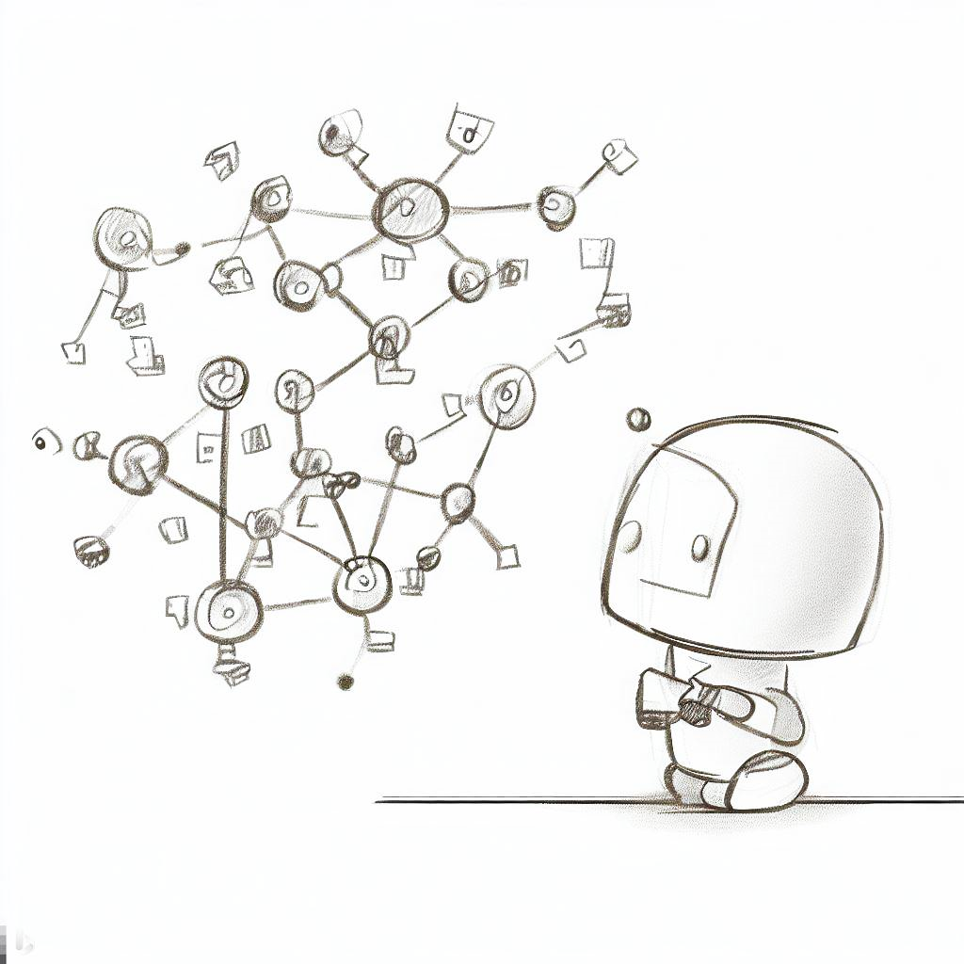
Interactive and Scalable Visualization for Cyclic, Directed Message Graphs
… by the example of Robot Operating System 2 Networks.
Valentin Schröter | Supervisor: Willy Scheibel
Start / Interim Presentation of the Master’s Thesis

Slide 2
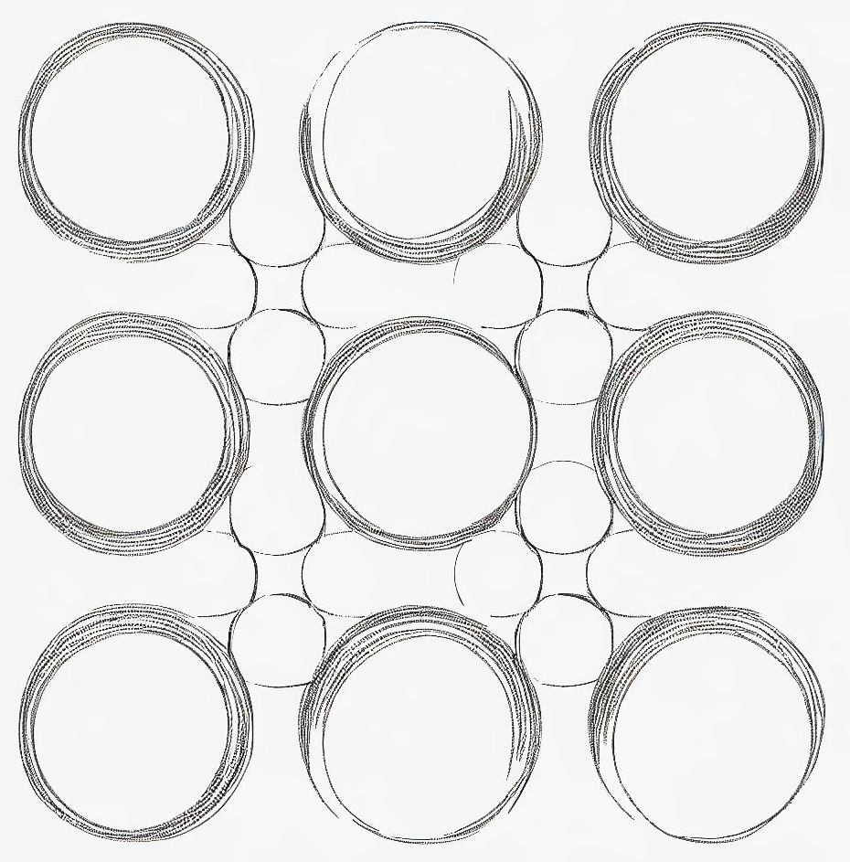
Motivation

Slide 3
Types of Graphs
Communication Graphs
Finite State Machines
Internet of Things
Social Networks

Slide 4
Challenges
Für Entwickler: nicht nur generelle Struktur im Big-Scale, sondern wirkliche Details zu Knoten / Teilen des Graphs wichtig

Slide 5
Related Work & State of the Art

Slide 6
State of the Art Tools

Slide 7
Content of the Master’s Thesis

Slide 8
Algorithms
Data Synthesis
Evaluation
Data Synthesis for Communication Graphs
Syntaktische Relevanz von Kanten
Lineare Sortierung mit Dataflow in mind
Visualization
Erkennen von Hierarchien
Compound Visualization for Overview and Detail View

Slide 9
What is ROS?

Slide 10




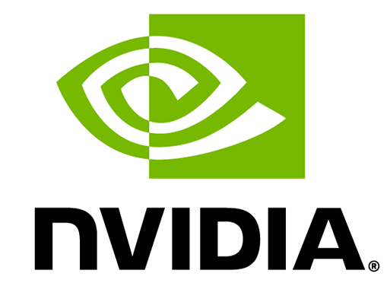

What is ROS?
package management
hardware abstraction
real time capabilities
Robot Operating System
[Quigley et al. 2009] & [Macenski et al. 2022]
ROS | AWS Robotics Blog (amazon.com)
node-based communication
leading framework for personal and industrial robot development
Isaac Robot Operating System (ROS) | NVIDIA Developer
ROS running on ISS - ROS robotics news

Slide 11
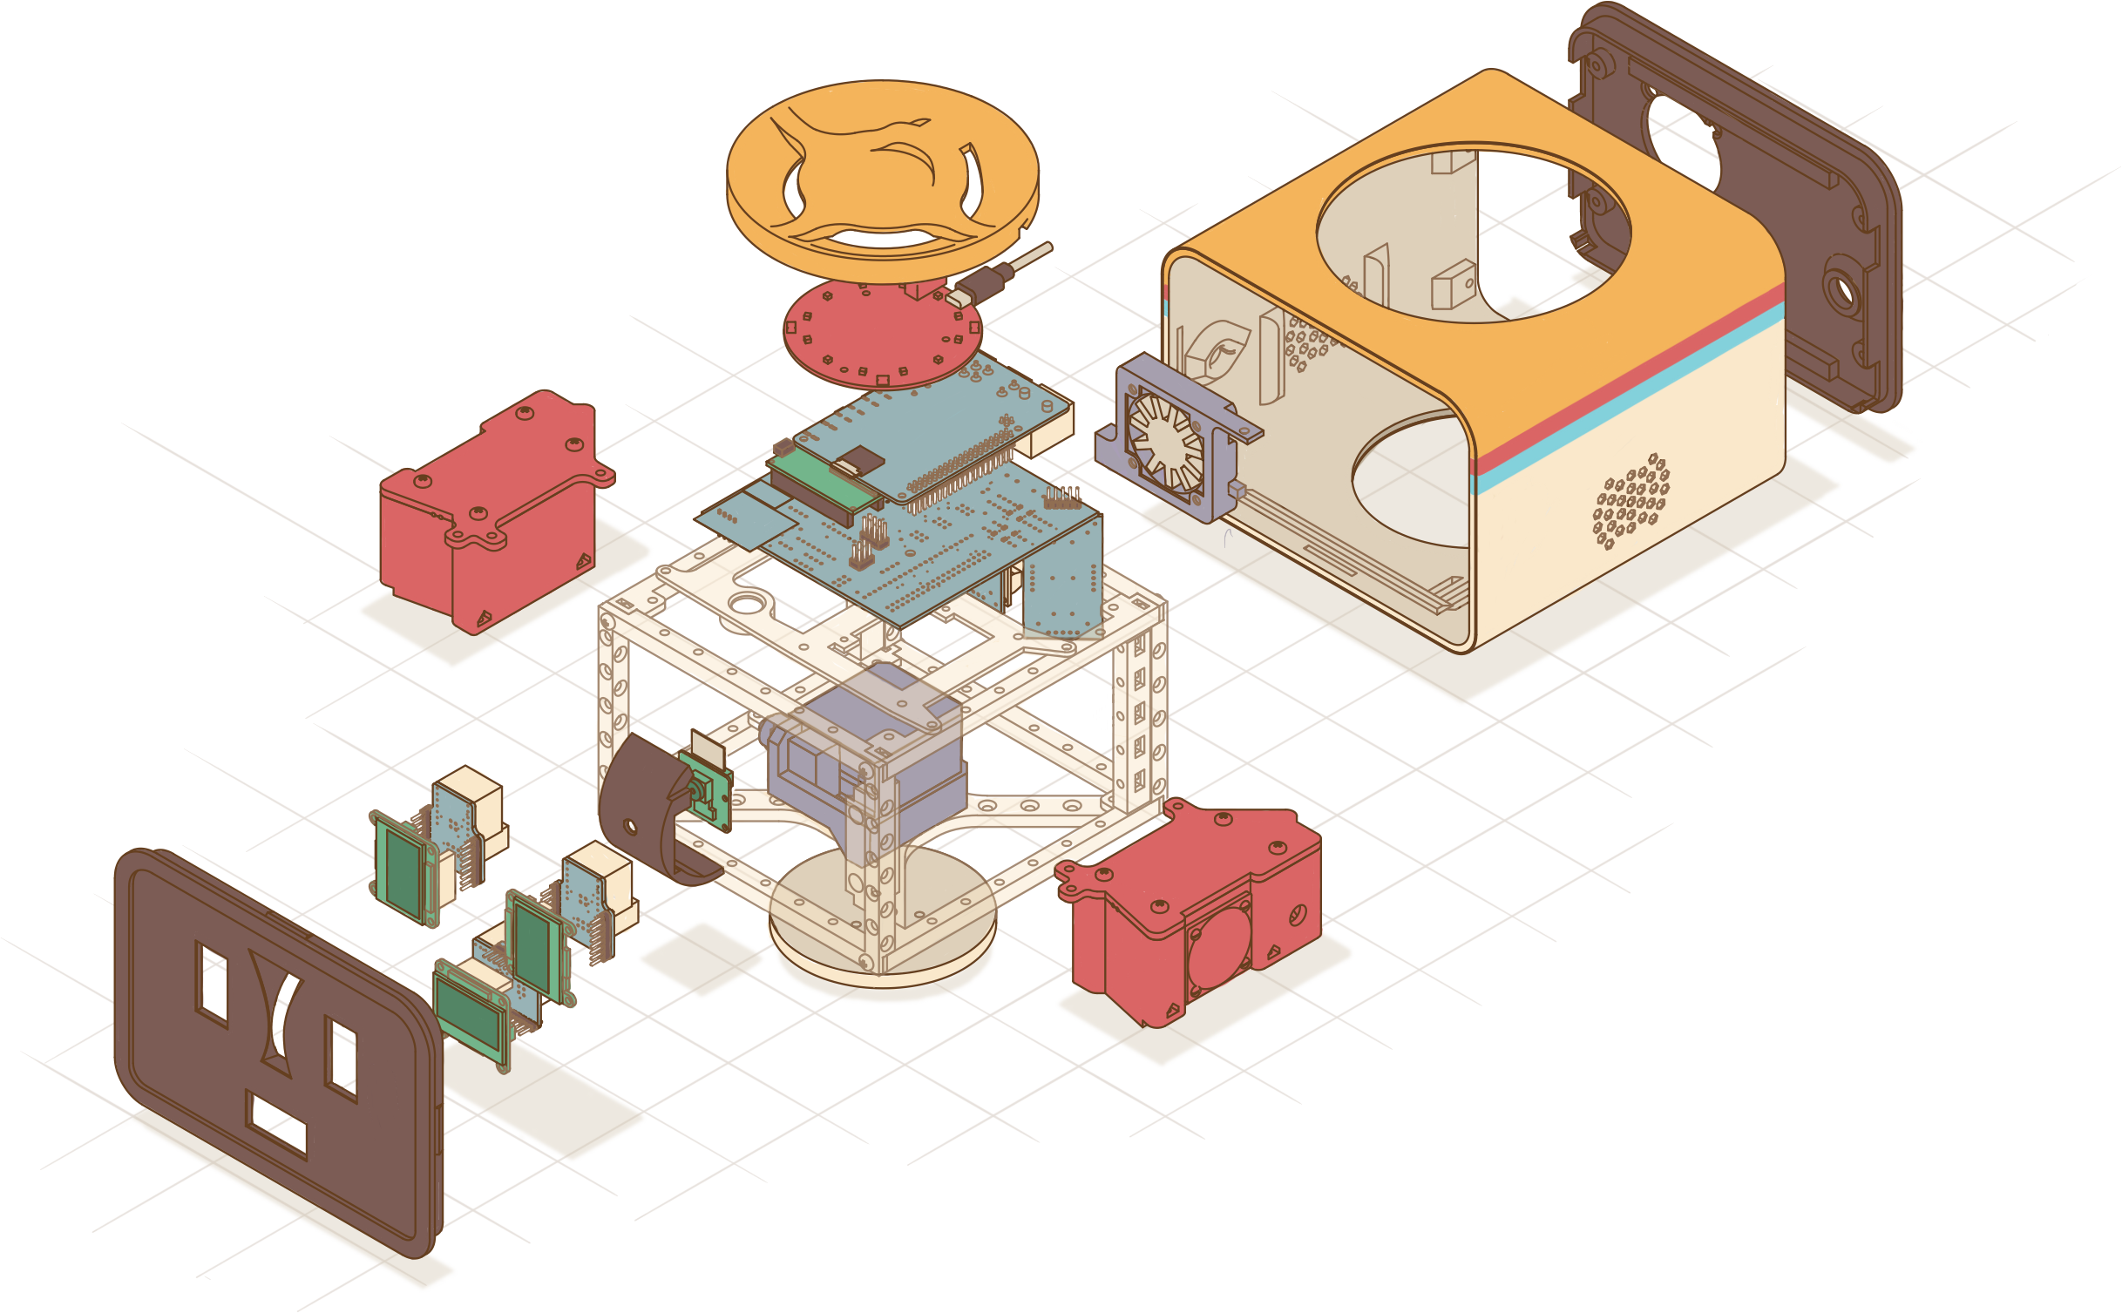
ROS Nodes
Interface Nodes:
I2C Interface
UART Interface
SPI Interface
Internal Nodes:
Resource Manager
Facial Expression Manager
Sound Tracking Controller
Face Recognition
SmartHome Control Interface
Sensor Nodes:
Microphone Array
Camera
Temperature
Actor Nodes:
Fan Control
Camera Motor
Stand Motor
Left Eye Display
Right Eye Display
Mouth Display
Speaker
LED Visualization
Speech Pipeline Nodes:
Keyword Detection
Speech To Text
Text To Speech
Natural Language Understanding
Sound Effects
Dialog Session Manager
Loudness Analyzer
Smalltalk
Jokes

Slide 12
ROS Node Communication
Publisher / Subscriber Communication
Call-and-response Communication
Message Topic
Node
/service
Node
Request
/topic
Node
Node
Node
Response
Publisher-Node
Subscriber-Nodes
Client-Node
Service Name
Server-Node
Node
/topic
Node
Node
Node
/service
Node
Node
Node
Node
Node
Node
single Server
/topic
Node
Node
multiple Clients
Node

Slide 13

Goal of the Project

Slide 14

What We Want to Visualize
Project Goal: Interactive visualization to support development process
Overview
Details
Developer wants to see…
… which nodes exist in the system!
… which topics are offered by a node!
… how the nodes are connected!
… incoming and outgoing connections of a selected node!
… which nodes are central / important / strongly connected!
… connection details:
message types, etc.

Slide 15
Scope of the Project
What the project should do?
What the project should not do?
Abstract visualization of a current system snapshot based on system introspection
Visualize concrete live data published by a node (like Data-Charts, Images, Audio Data, Point Clouds, etc.)
→ support development process at a higher level
Allow live manipulation of the system (e.g., changing the connections between nodes)

Slide 16
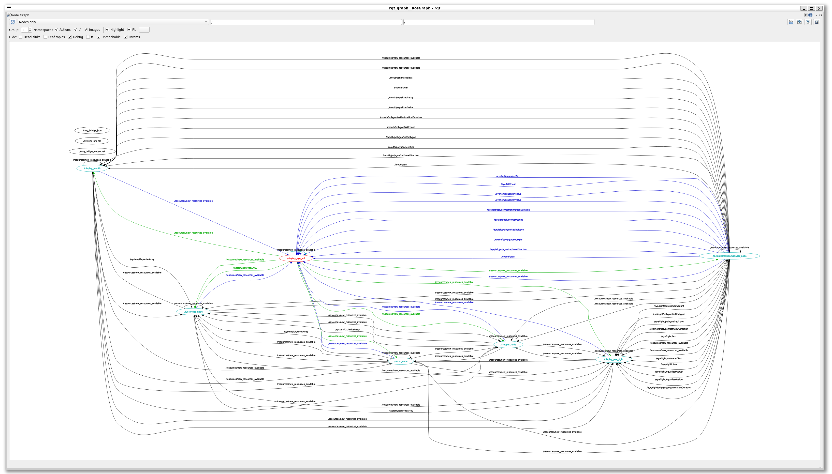
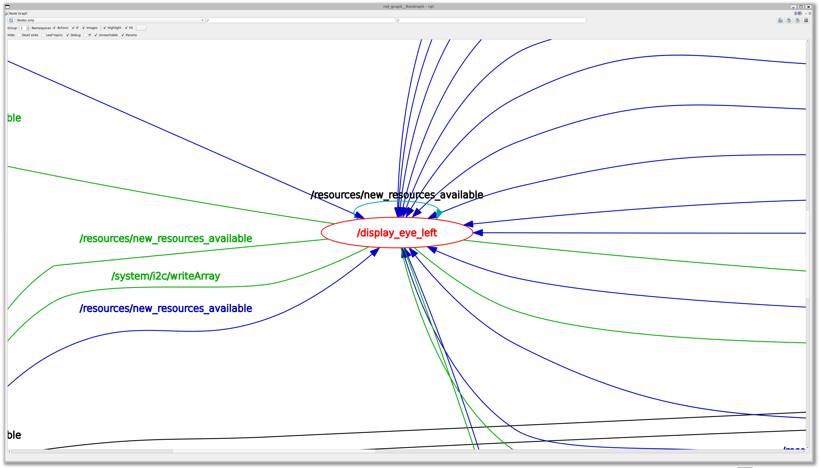
State of the Art
Project ‘rqt_graph’
ros-visualization/rqt_graph (github.com)

Slide 17
rqt_graph
Node-only view of 10 nodes

Slide 18
rqt_graph
Node-only view of 10 nodes
Shows nodes, incoming and outgoing connections

Slide 19
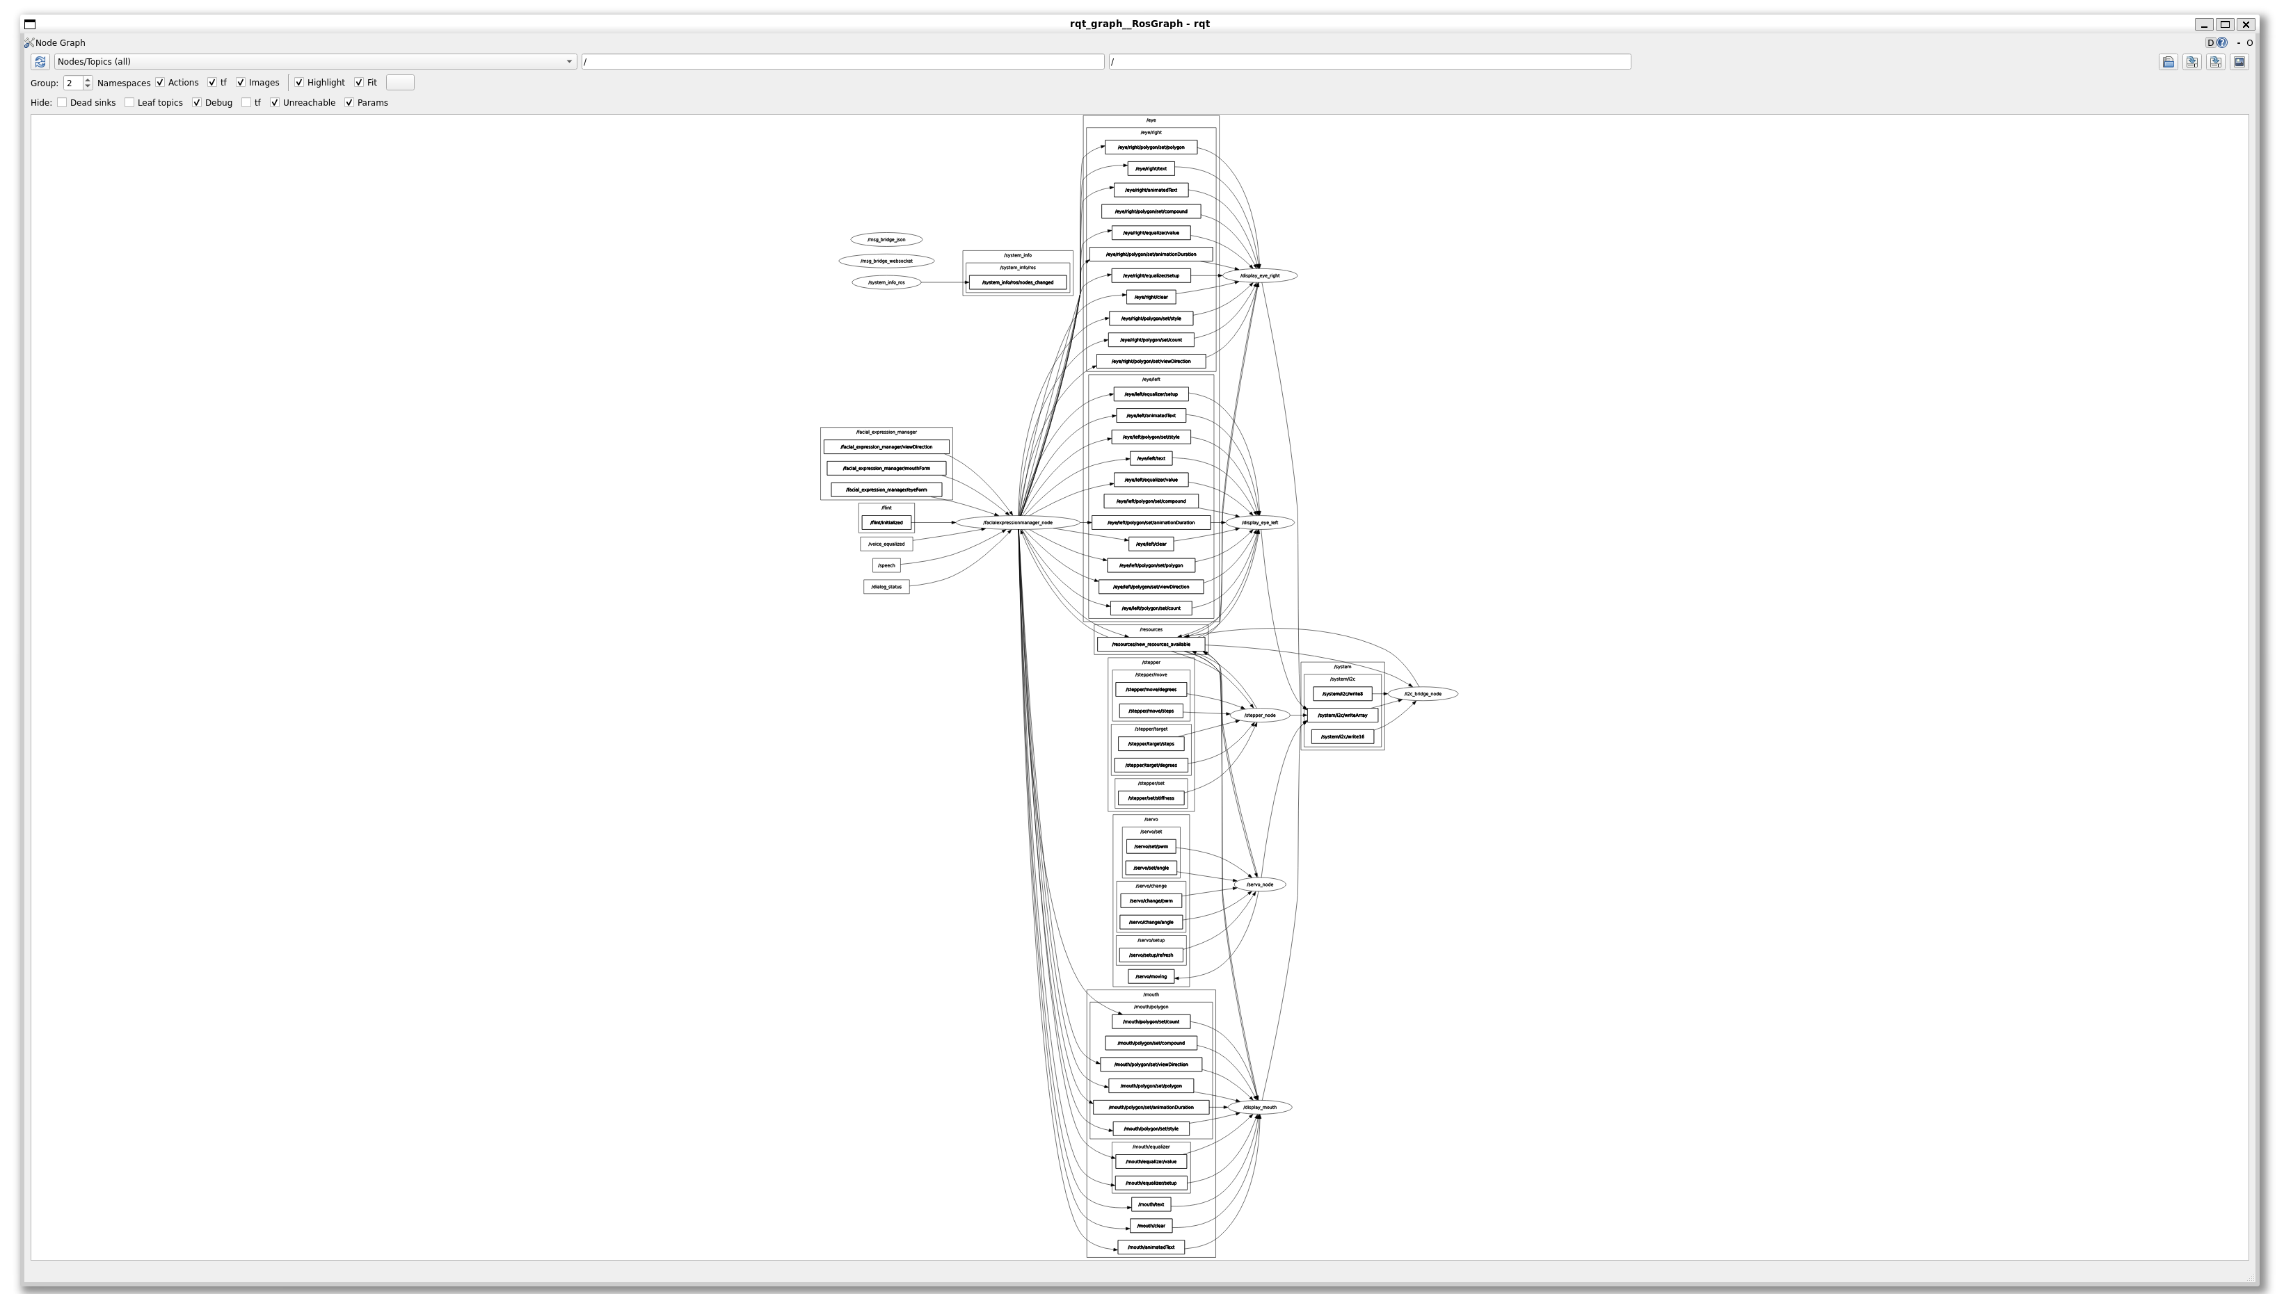
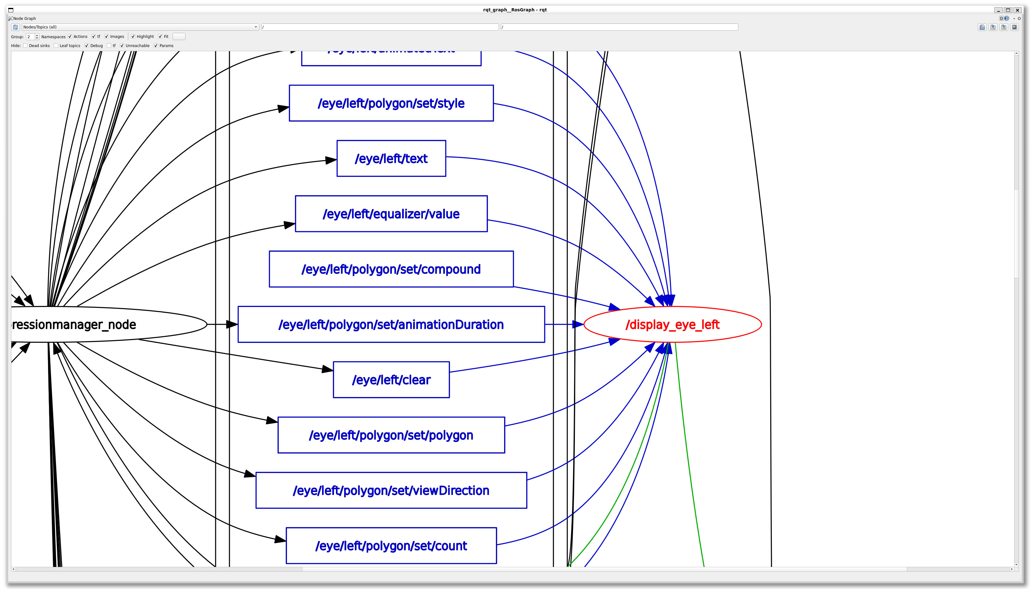
rqt_graph
Node/Topics view of 10 nodes

Slide 20
rqt_graph
Node/Topics view of 10 nodes
Shows nodes and their topics

Slide 21
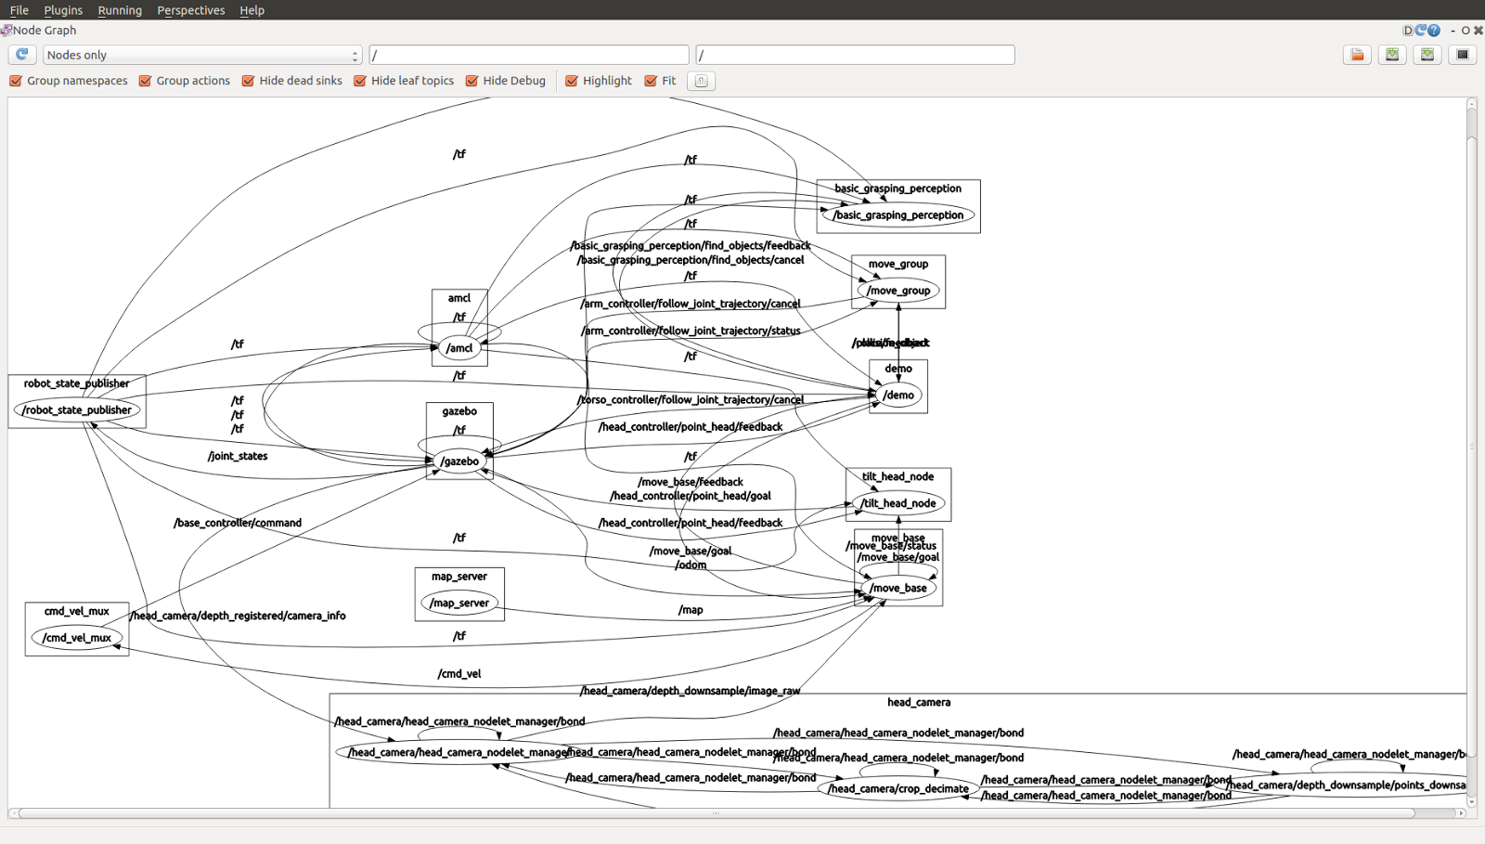

Problems of rqt_graph
visual cluttering
the only interactions:
hover, zoom, pan
requires a ROS Desktop environment
manual refreshing

Slide 22
Other ROS Visualizations?

Slide 23
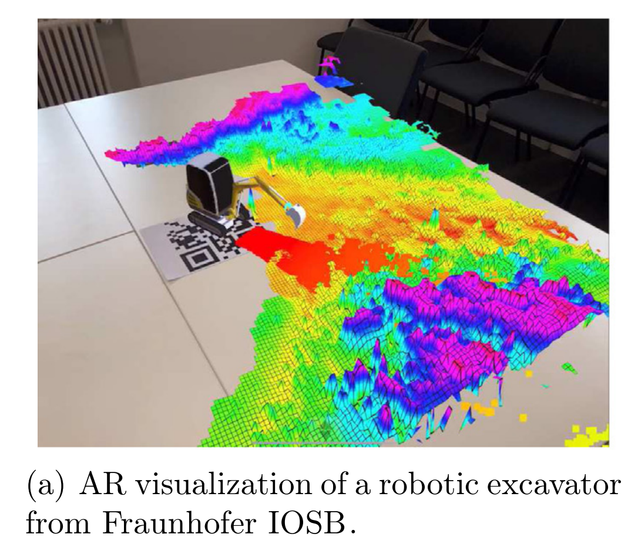
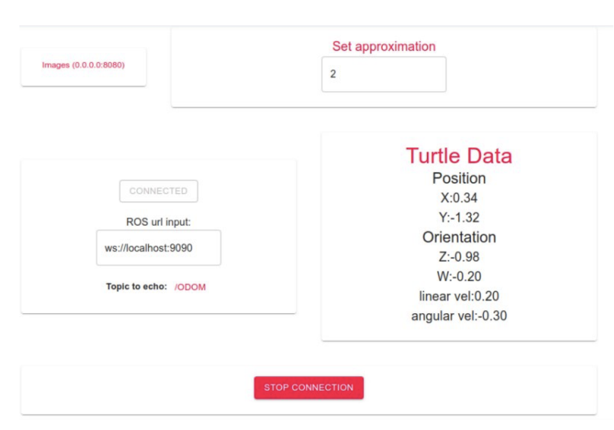
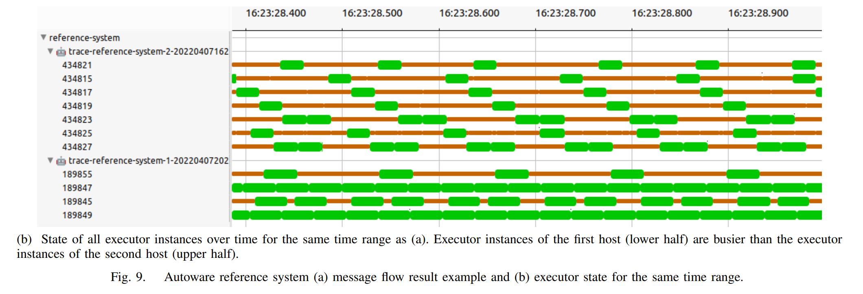
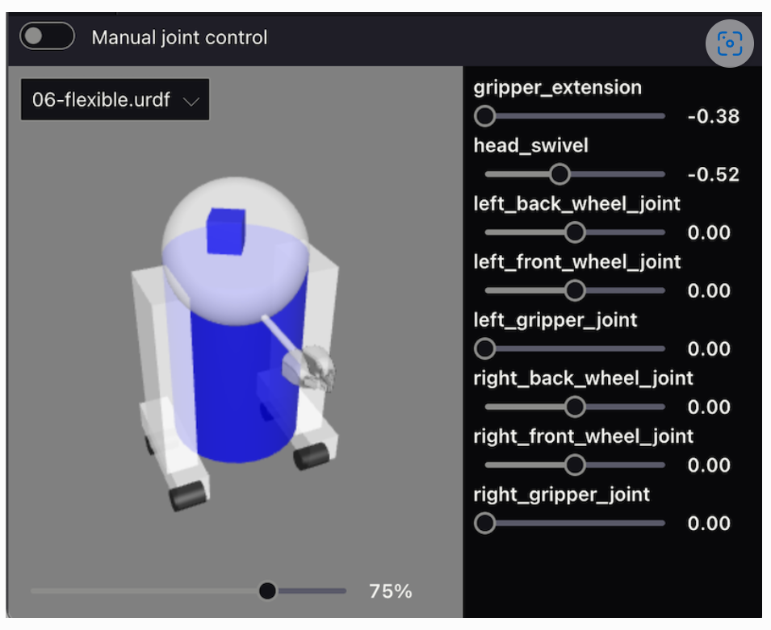
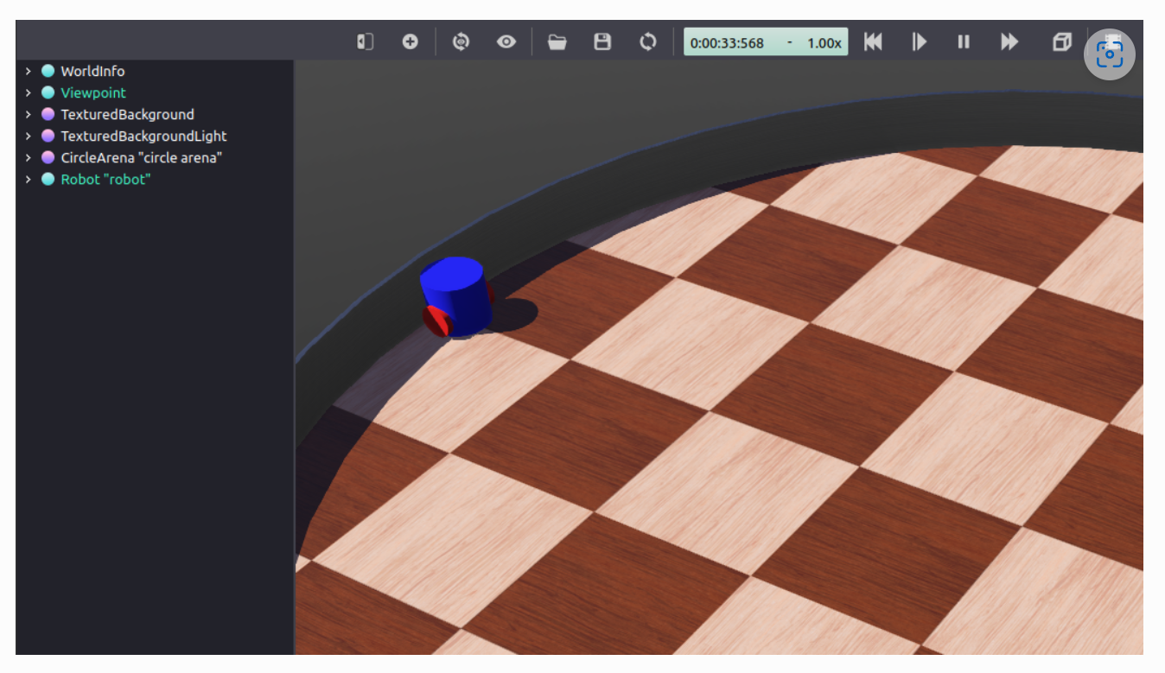
Other Visualizations and Related work
Ivanov, Artem, et al. "Online monitoring and visualization with ros and reactjs." 2021 International Siberian Conference on Control and Communications (SIBCON). IEEE, 2021.
Bédard, Christophe, et al. "Message flow analysis with complex causal links for distributed ROS 2 systems." Robotics and Autonomous Systems 161 (2023): 104361.
Zea, Antonio, and Uwe D. Hanebeck. "iviz: A ROS visualization app for mobile devices." Software Impacts 8 (2021): 100057.
Setting up a robot simulation (Basic) — ROS 2 Documentation: Foxy documentation
Visualizing ROS 2 data with Foxglove Studio — ROS 2 Documentation: Foxy documentation

Slide 24
Why Not Just Expanding rqt_graph?

Slide 25
Architecture in rqt_graph
Desktop Server System (Linux, etc.)
ROS-Environment
Meta-info about the current nodes in the system
rqt_graph
User Access
ROS-Nodes
Arbitrary nodes in the system
Qt-App and ROS-Node

Slide 26
Architecture in rqt_graph
Desktop Server System (Linux, etc.)
ROS-Environment
rqt_graph
User Access
ROS-Nodes
Qt-App and ROS-Node
rqt_graph is simultaneously…
… a ROS Node
and
… a qt5 application
You need simultaneously …
… a ROS Environment
and
… a Desktop Environment

Slide 27

Goal of the New Approach
rqt_graph needs simultaneously…
… a ROS Environment
and
… a Desktop Environment
We want to have independently:
… a ROS Environment
and
… any device to visualize the ROS Environment

Slide 28
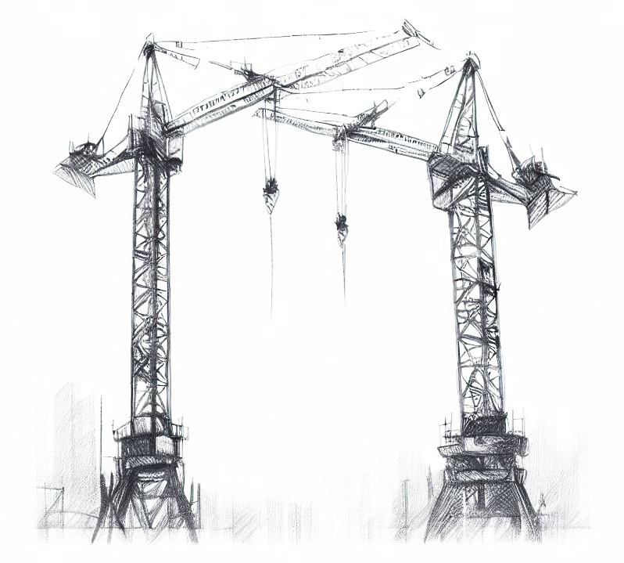
Architecture of the New Approach

Slide 29
Architecture in rqt_graph
Desktop Server System (Linux, etc.)
ROS-Environment
Meta-info about the current nodes in the system
rqt_graph
User Access
ROS-Nodes
Arbitrary nodes in the system
Qt-App and ROS-Node simultaneously
== ROS-Nodes (Python/C++)

Slide 30

New System Architecture
Desktop Server System (Linux, etc.)
ROS-Environment
Meta-info about the current nodes in the system
provided Services
Request ROS data via WebSockets
SystemInfo Node
/get_all_node_names
ROS-Bridge Server
WebApp for Visualization
User Access
ROS-Nodes
/get_publisher_by_node
/get_subscriber_by_node
…
Arbitrary nodes in the system
ROS-Node dedicated to provide meta-info
Generic
ROS-to-WebSocket Bridge
== ROS-Nodes (Python/C++)
== Web-App (Node.js + TypeScript)
== Developed during the project

Slide 31






Technical Details
ROS-System
Visualization WebApp
Platform
Ubuntu 22.04
Platform
theoretically any web browser platform
Framework
ROS2 Humble (current LTS)
Framework
Node.js
Vue.js
D3.js
Quasar (CSS-Framework)
Languages
Python for custom ROS-Nodes
Languages
TypeScript
SystemInfo Node
ROS Intrinsics
ROS-Bridge Server
Python Websockets
Libraries
TypeScript Reimplementation of RobotWebTools/roslibjs: The Standard ROS JavaScript Library (github.com)
Python reimplementation of RobotWebTools/rosbridge_suite: Server Implementations of the rosbridge v2 Protocol (github.com)
Notes:
theoretisch jede Plattform, da nur offene und standardisierte Web-Technologien eingesetzt werden

Slide 32










Restrictions With the Architecture
WebApp enables use on theoretically any platform
SVG Rendering may depend on specific browser
Chromium-based
… needed some workarounds for SVG-Text-Rendering

Slide 33
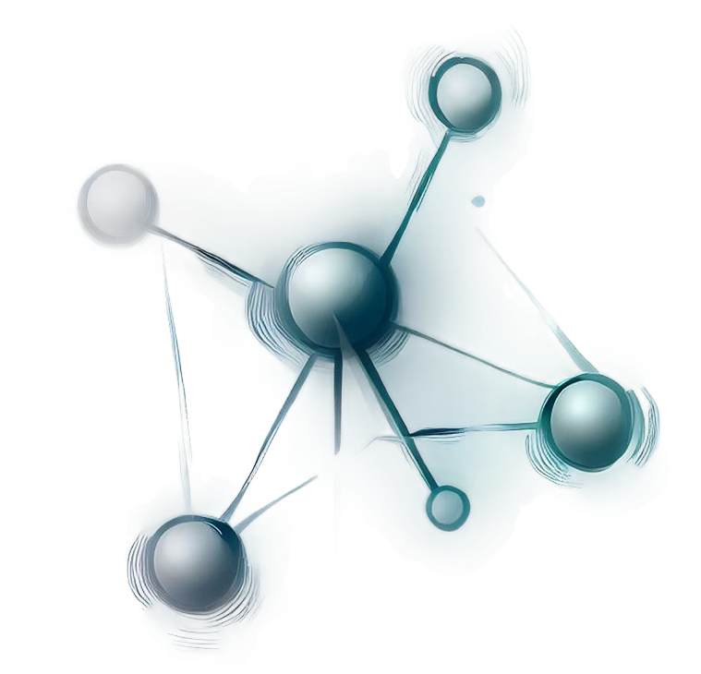
The Visualization

Slide 34
Visualization of the Overview
Nodes
Overview
… which nodes exist in the system!
… how the nodes are connected!
Connections
… which nodes are central / important / strongly connected!

Slide 35

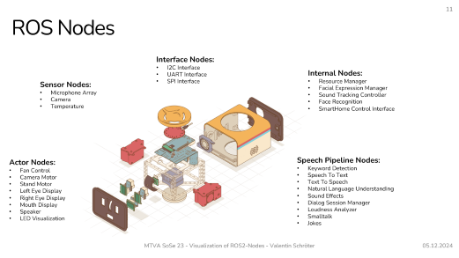
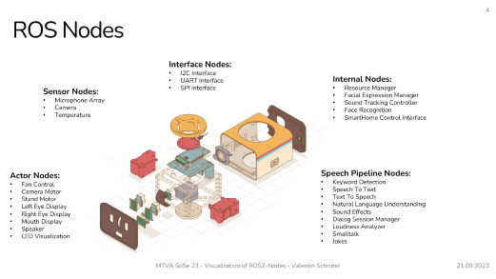
Characteristics of the ROS Nodes
Different types of nodes?
In terms of semantics?
Nodes for sensor input, actor output, image processing, internal management, etc…
Yes
In terms of syntax?
Nodes as collections
of connections
No
No different types of nodes!
This project: Visualization based on system introspection
No hierarchies!

Slide 36
Characteristics of the Node Connections

Slide 37
Publisher / Subscriber Connections
Publisher / Subscriber communication
Message Topic
Node
Node
/topic
Node
Publisher-Node
Subscriber-Nodes
Example:
Microphone
Recorder
/audio
Dataflow
Publisher / Subscriber communication determines a data flow direction!
always?

Slide 38
Broadcast Connections
Example:
Microphone
Recorder
/new_node_created
Manager
simultaneous publisher & subscriber on the same topic
Use Cases:
- internal parameters
Dataflow in both directions
„Broadcast Connections“
= self-defined idiom
- resource management
- etc…

Slide 39
Client / Server Connections
Call-and-response Communication
/service
Request
Node
Node
Response
Client-Node
Service Name
Server-Node
Example:
Microphone
/audio
Dataflow?
Recorder
/start_recording
Manager

Slide 40
Client / Server Connections
Microphone
/audio
Use cases for Client / Server communication
Recorder
/start_recording
Trigger action
Manager
Get data
/recording_status
Send data
Manager
/set_volume
Manager
No clear dataflow without semantics

Slide 41



Characteristics of Connections
Pub / Sub connections
Broadcast connections
Service connections
Strictly define a data flow direction
Nodes are interchangeable
Unknown dataflow direction

Slide 42

Let’s Get an Overview

Slide 43
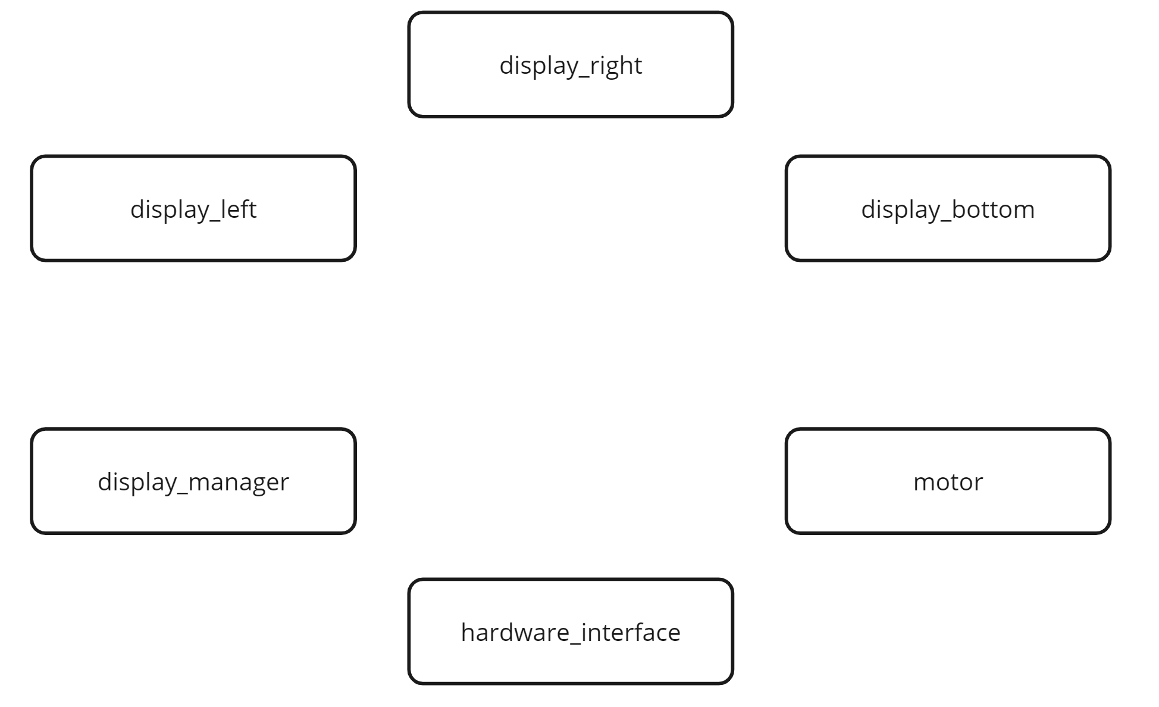
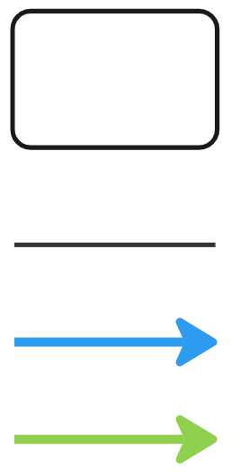
Example System: Nodes
ROS-Node
any connection between nodes
Publisher / Subscriber connection
Client / Service connection

Slide 44
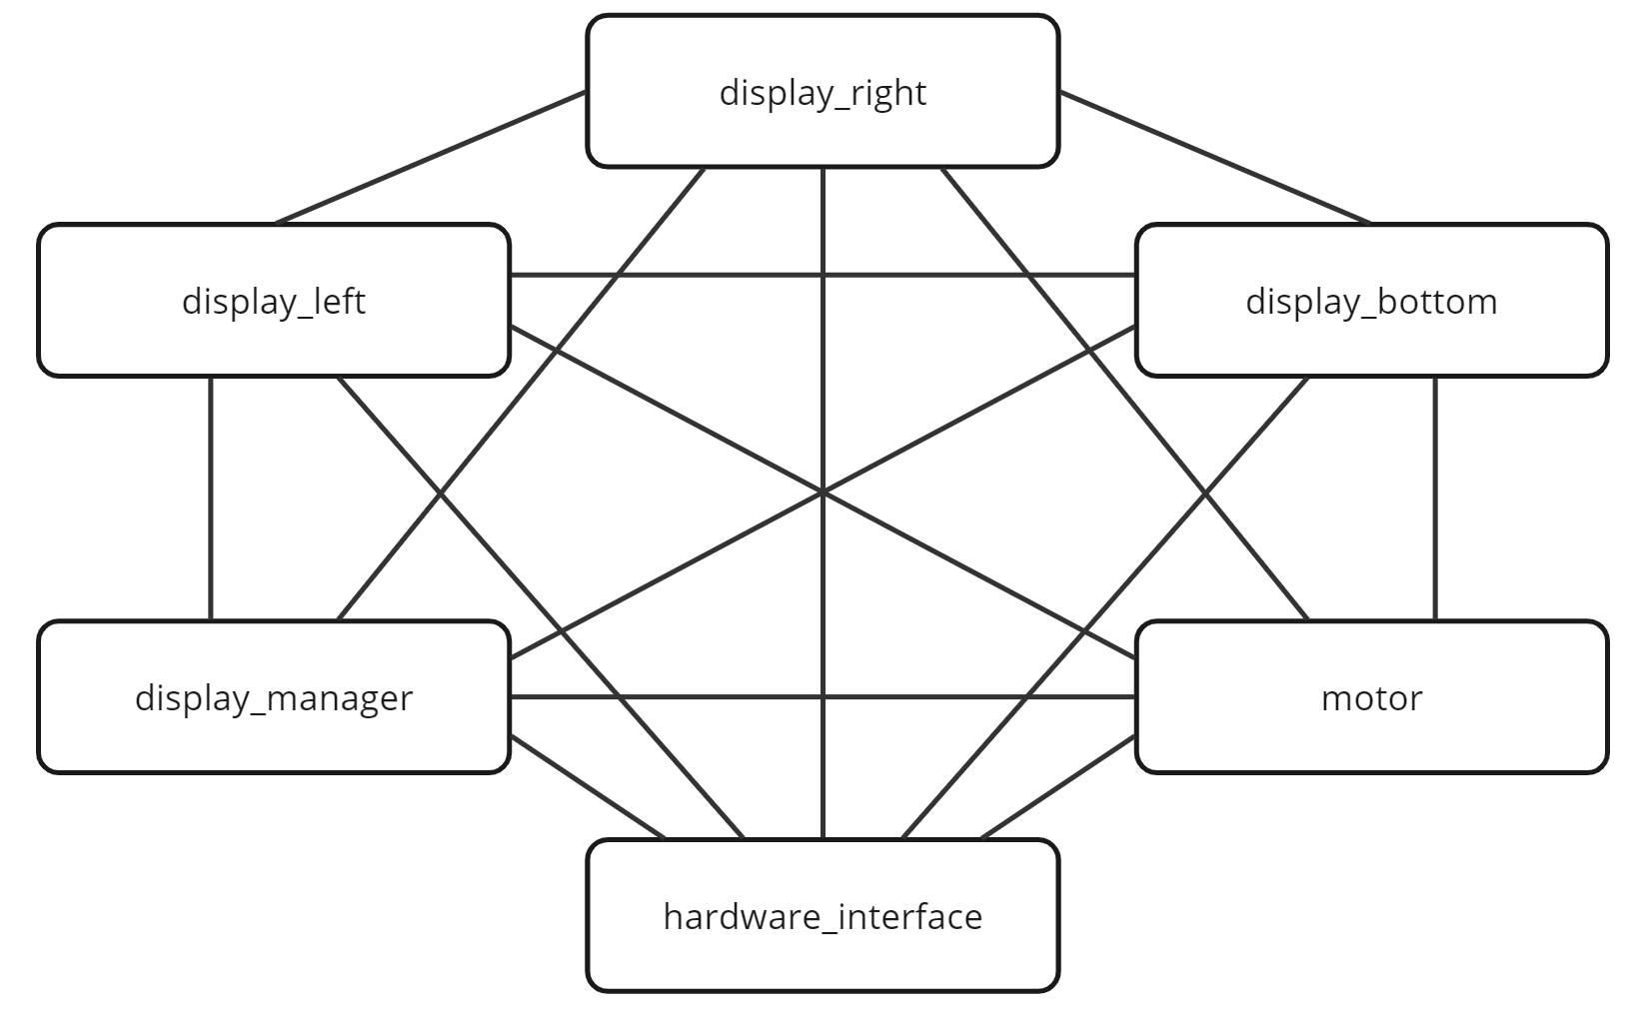
Example System: All Connections
ROS-Node
any connection between nodes
Publisher / Subscriber connection
Client / Service connection
Sort of
Force-Directed-Graph
→ not suitable for good overview

Slide 45
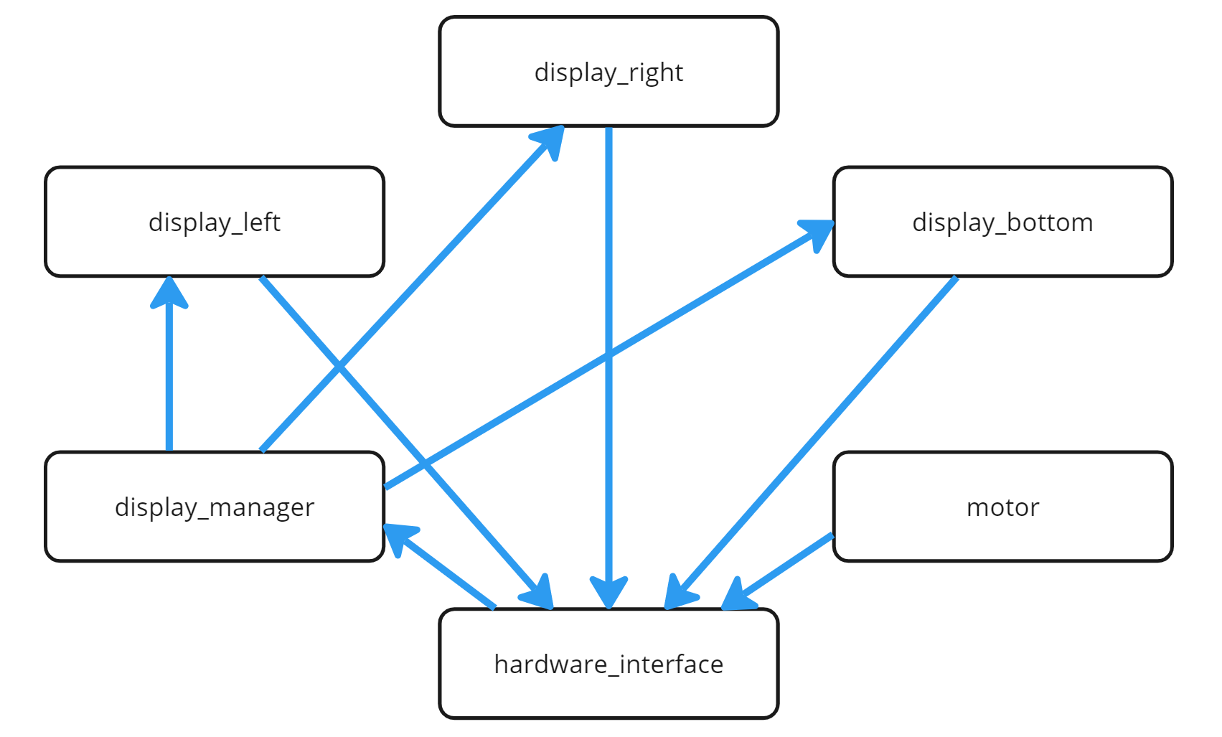
Example System: Pub / Sub Connections
ROS-Node
any connection between nodes
Publisher / Subscriber connection
Client / Service connection

Slide 46
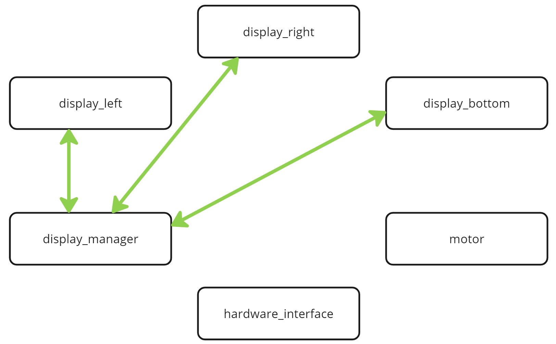
Example System: Service Connections
ROS-Node
any connection between nodes
Publisher / Subscriber connection
Client / Service connection

Slide 47

Approaches to Handle Connections
The goal:
Bringing some structure into that node set!

Slide 48
Approaches to Handle Connections
Pub / Sub connections
Broadcast connections
Service connections
Strictly define a data flow direction
Nodes are interchangeable
Unknown dataflow direction
1. Ignore Services
Main criterion for the structure!
Ignore Broadcast completely
Approach
or
2. Define clients as outgoing, servers as ingoing (assumption)

Slide 49
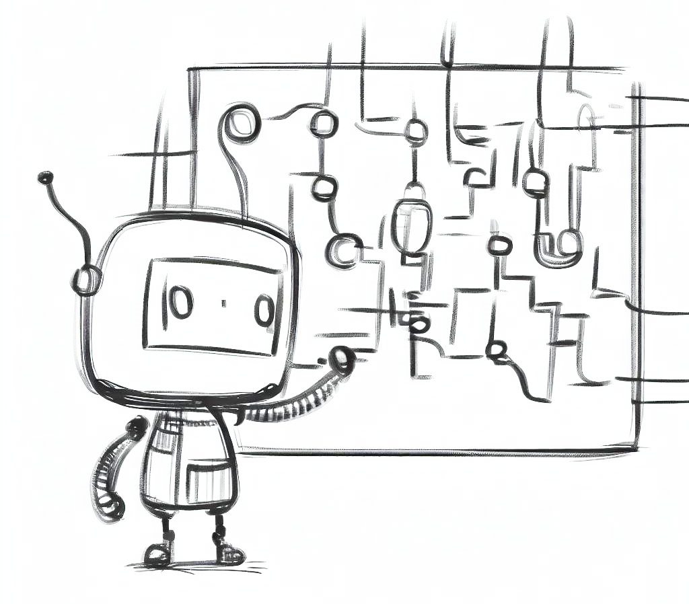
Get Topological Generations

Slide 50
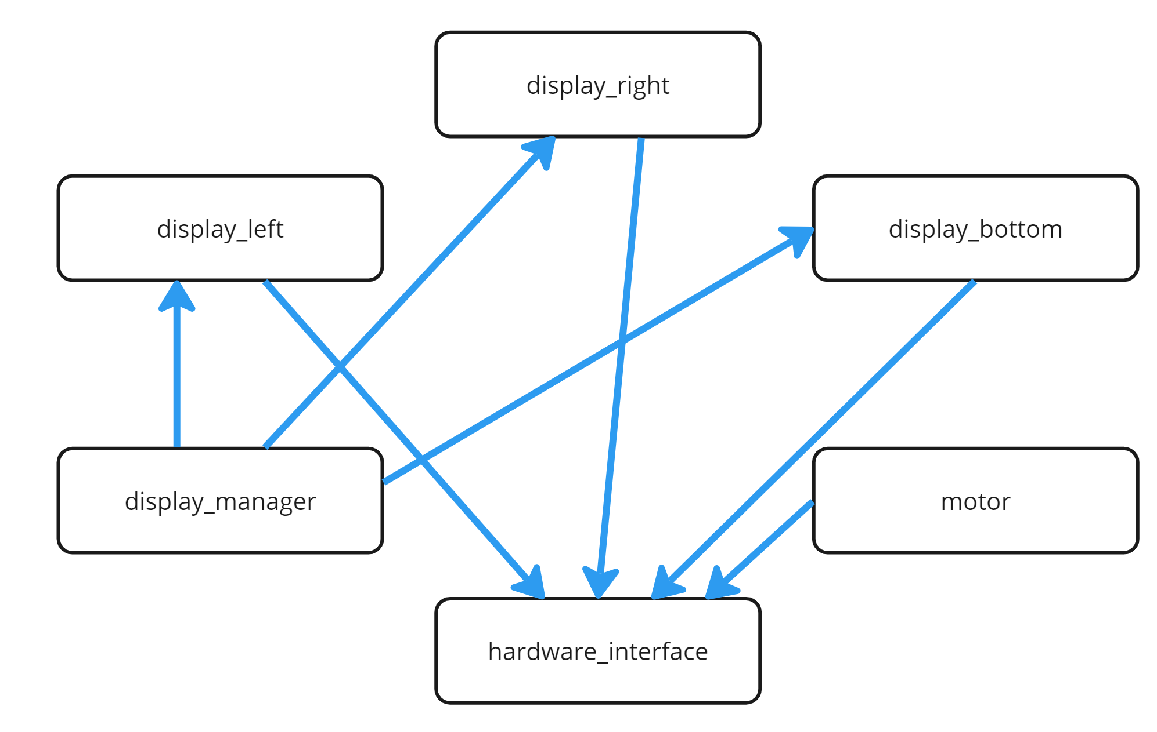
What are Topological Generations?
“A topological generation is node collection in which ancestors of a node in each generation are guaranteed to be in a previous generation, and any descendants of a node are guaranteed to be in a following generation. Nodes are guaranteed to be in the earliest possible generation that they can belong to.” NetworkX Documentation

Slide 51
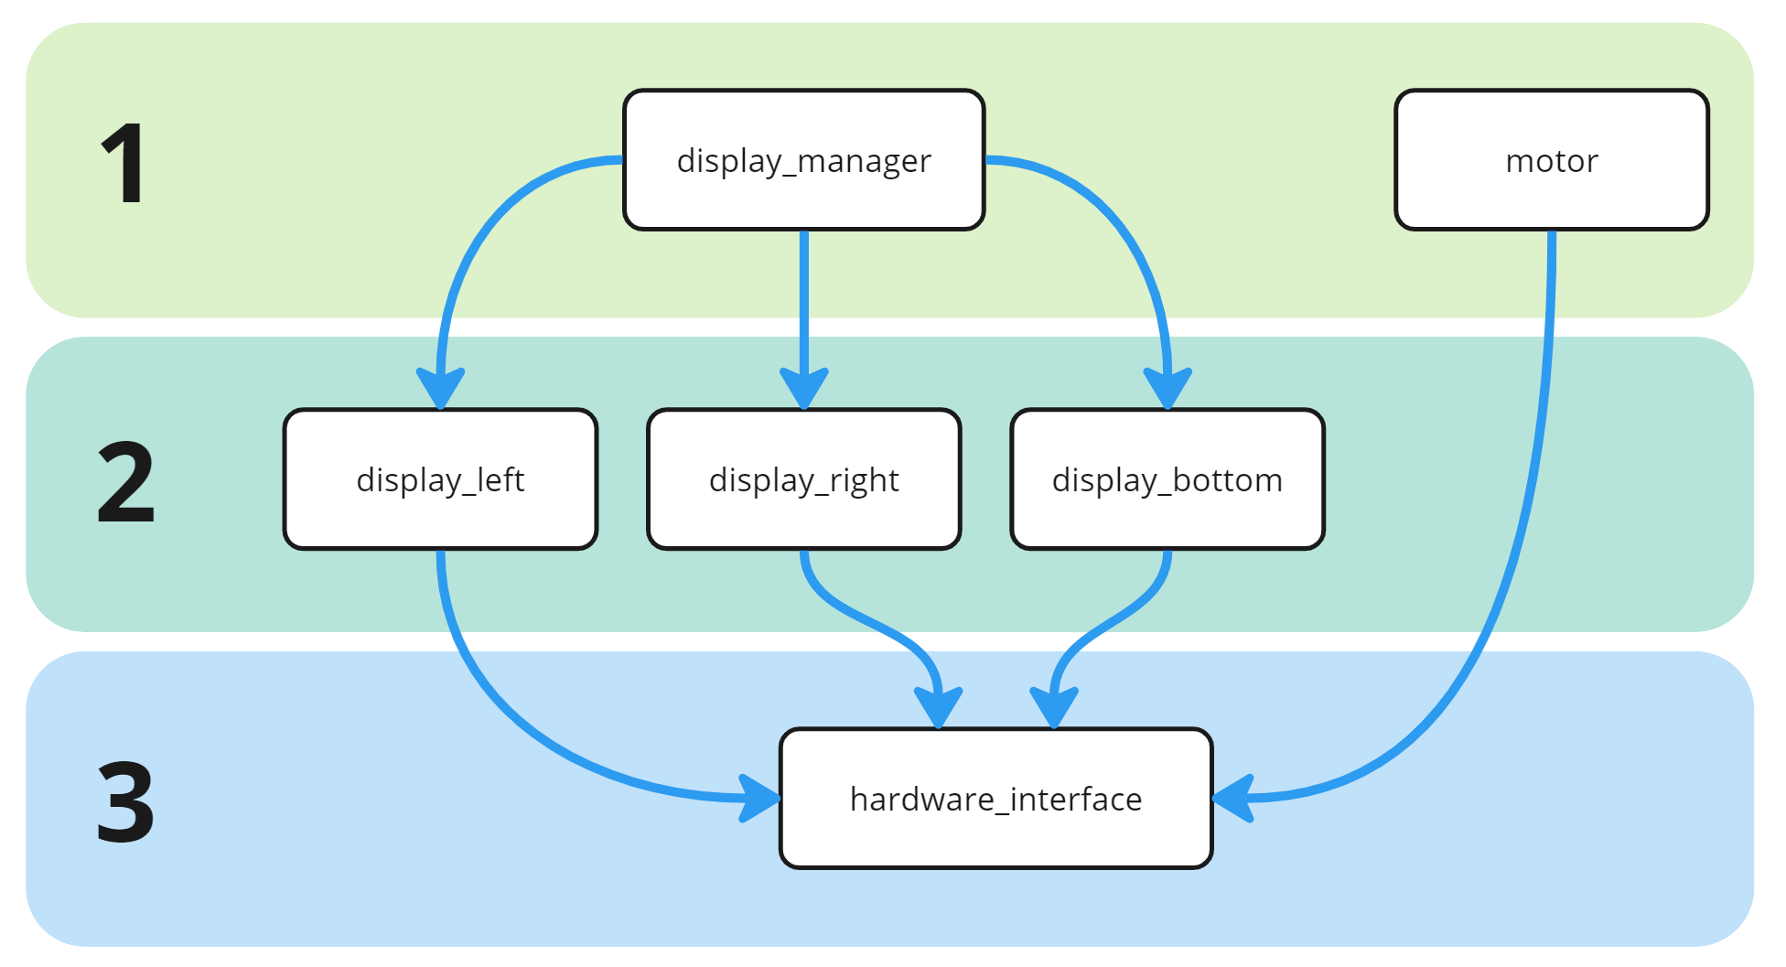
What are Topological Generations?
“A topological generation is node collection in which ancestors of a node in each generation are guaranteed to be in a previous generation, and any descendants of a node are guaranteed to be in a following generation. Nodes are guaranteed to be in the earliest possible generation that they can belong to.” NetworkX Documentation
Only works for DAGs (Directed Acyclic Graphs)

Slide 52
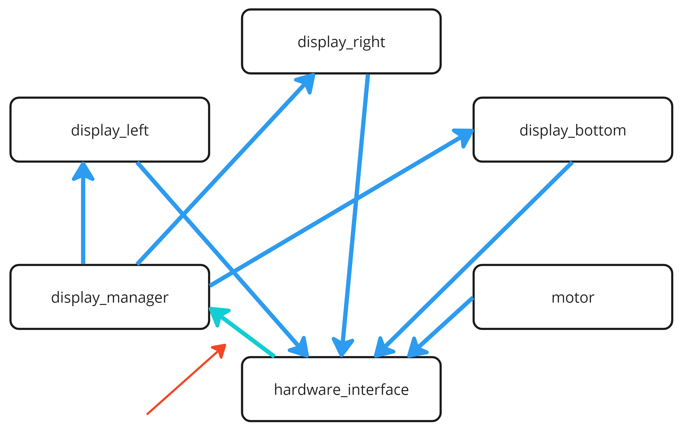
Topological Generations in Non-DAGs?
what if we have a cycle?
(common in ROS)

Slide 53
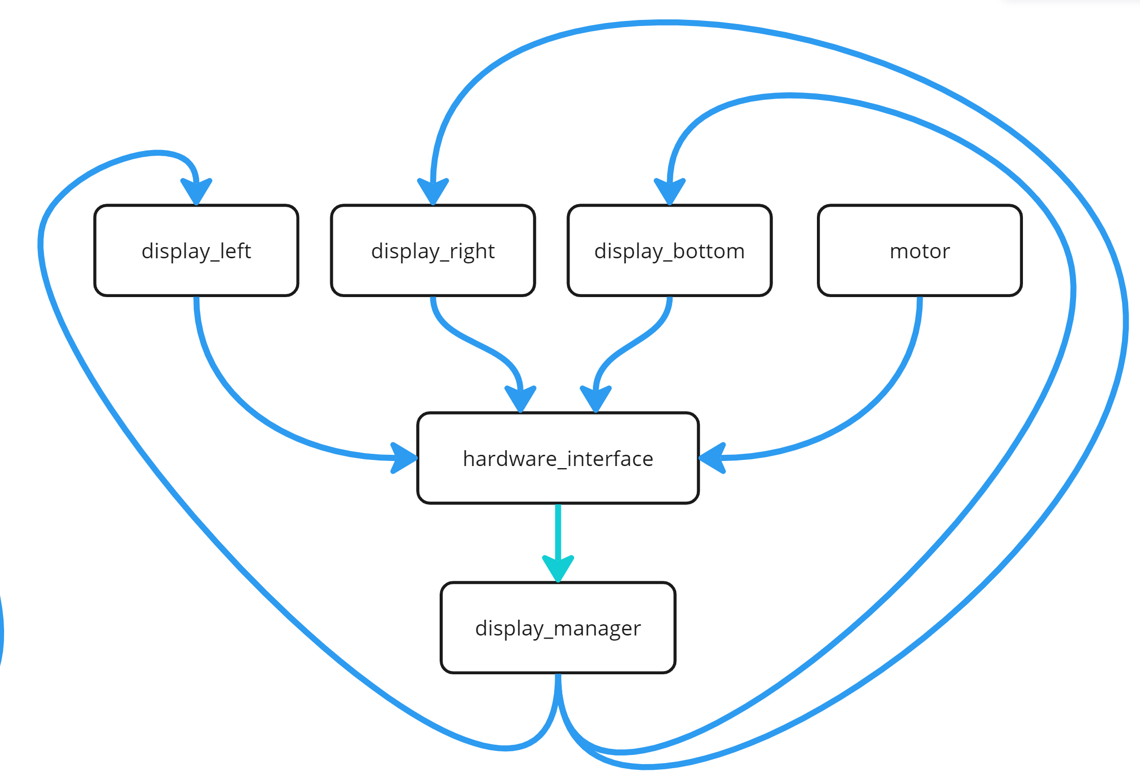
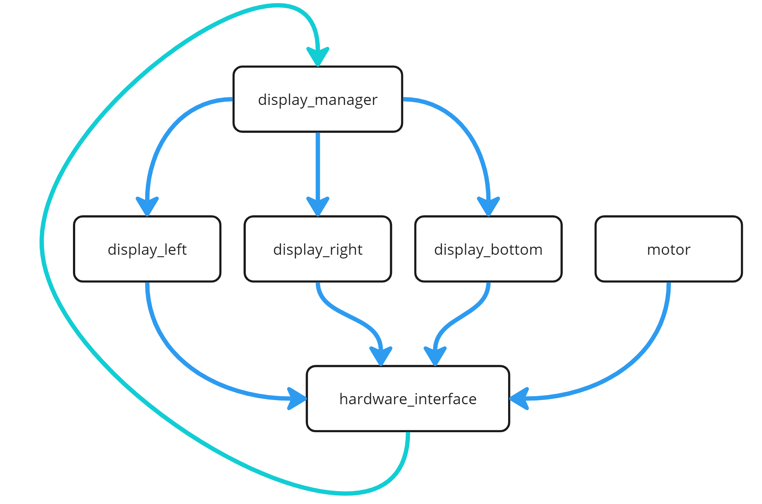
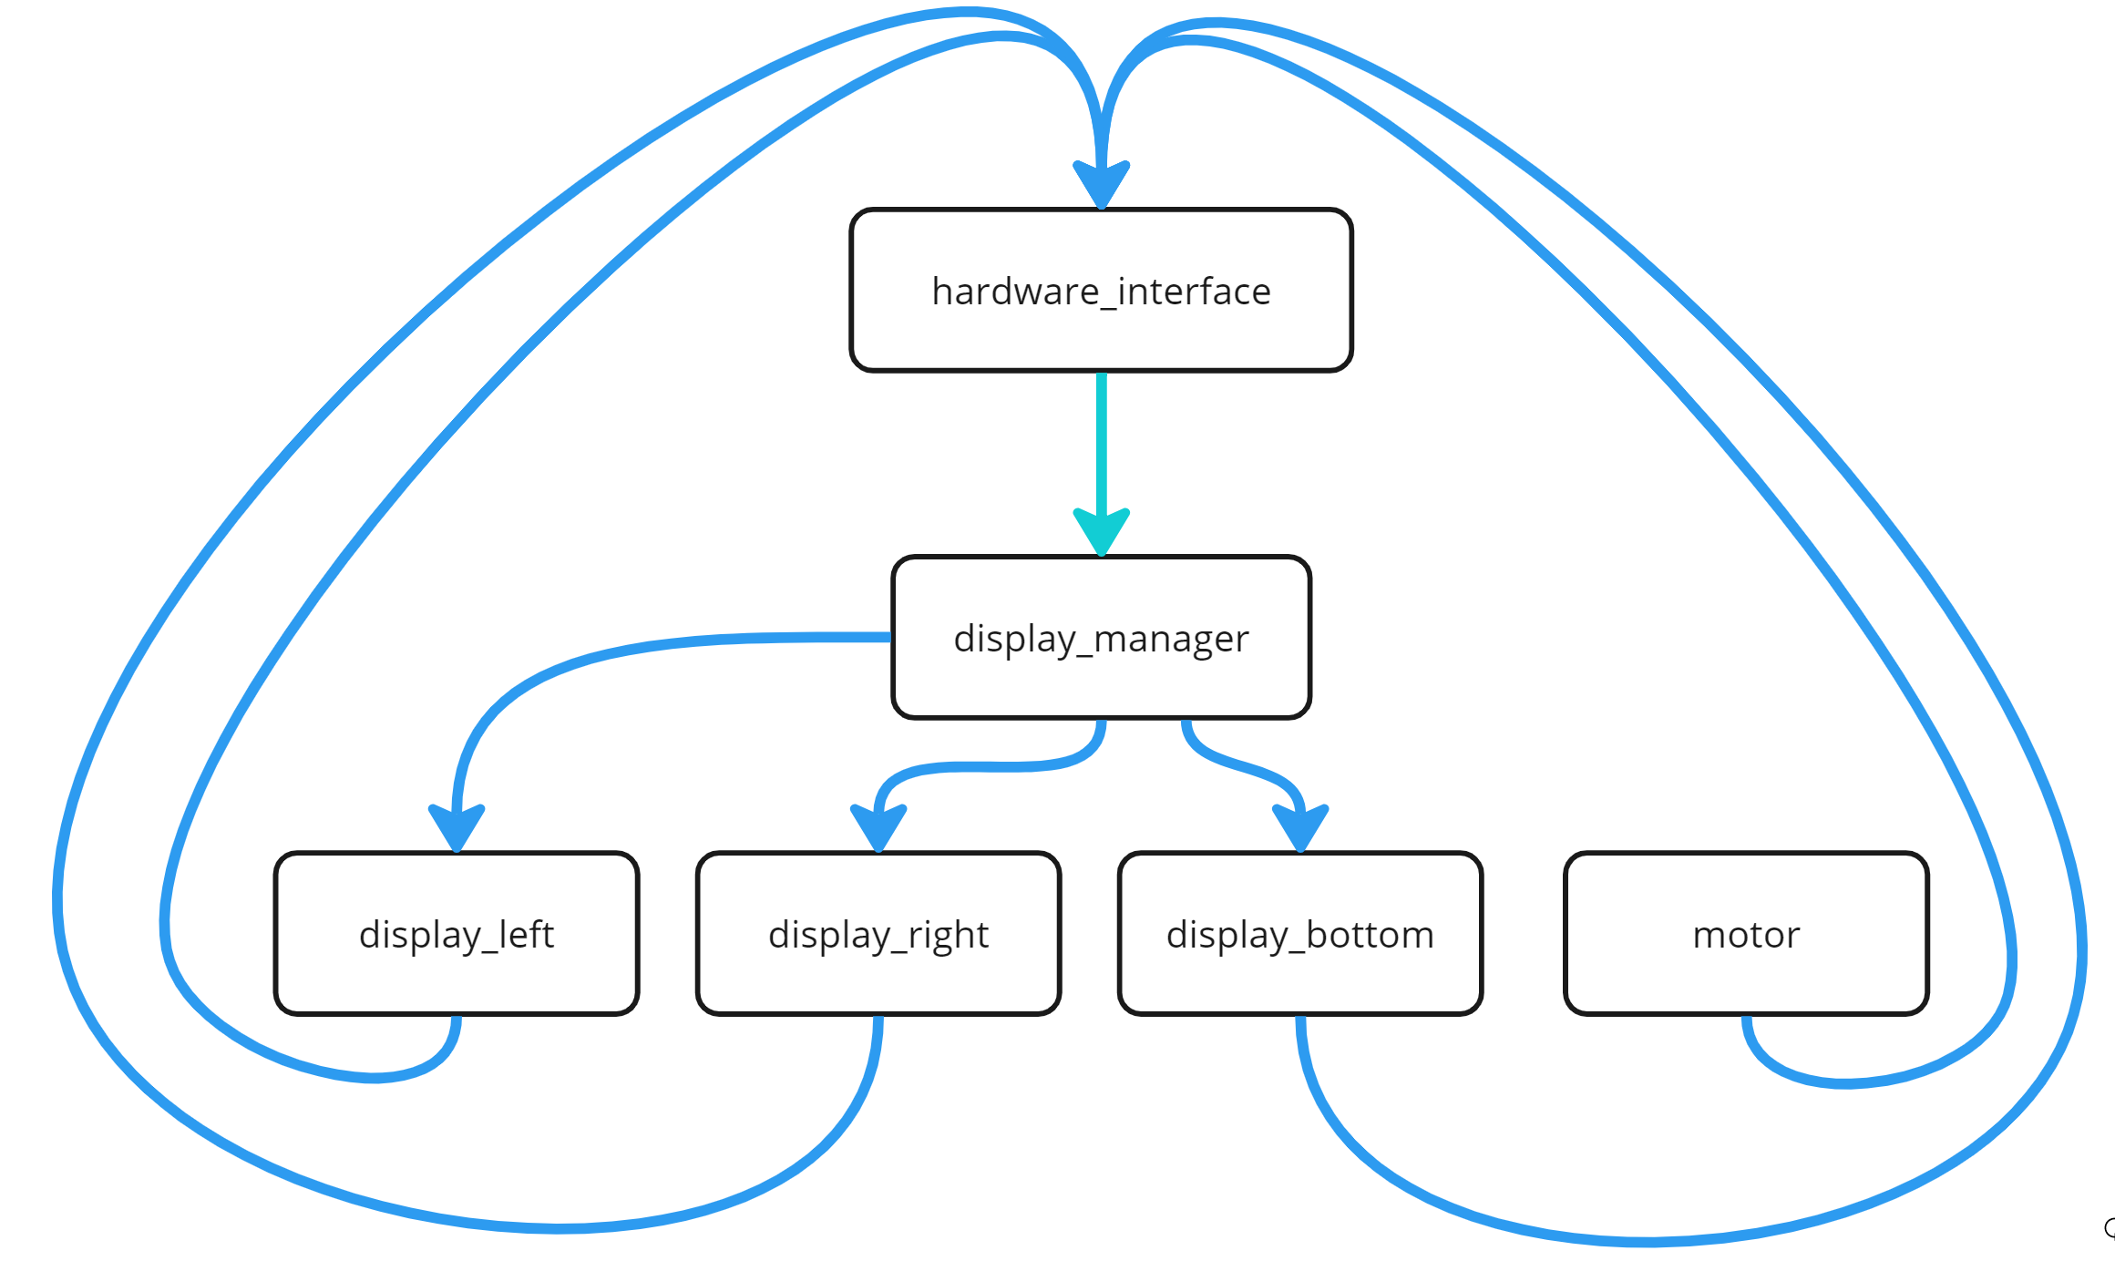
Topological Generations in Non-DAGs?
Topological generations become ambiguous

Slide 54

Selecting a Start Node

Slide 55
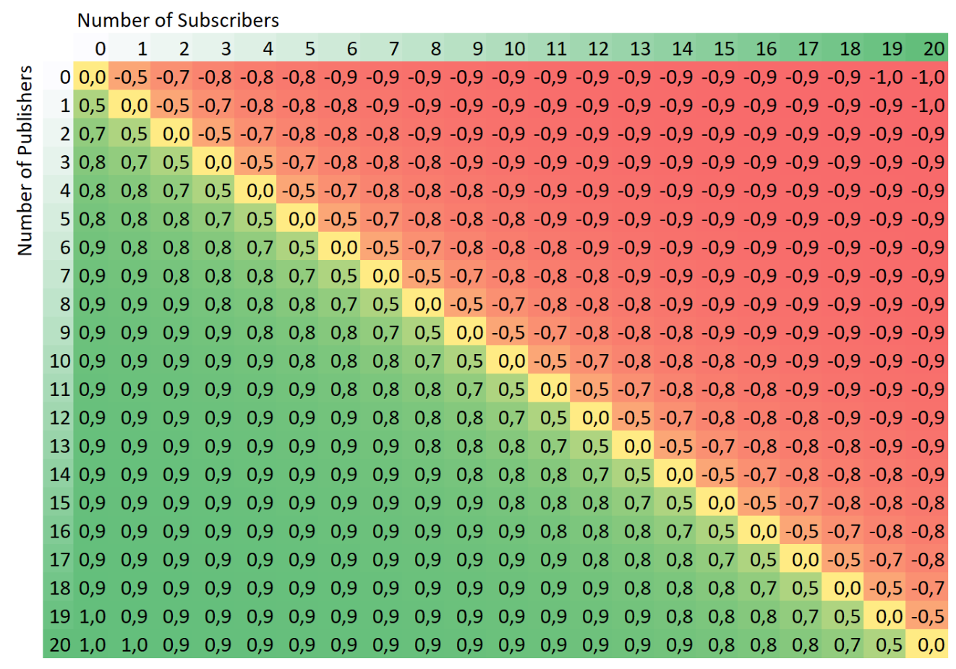
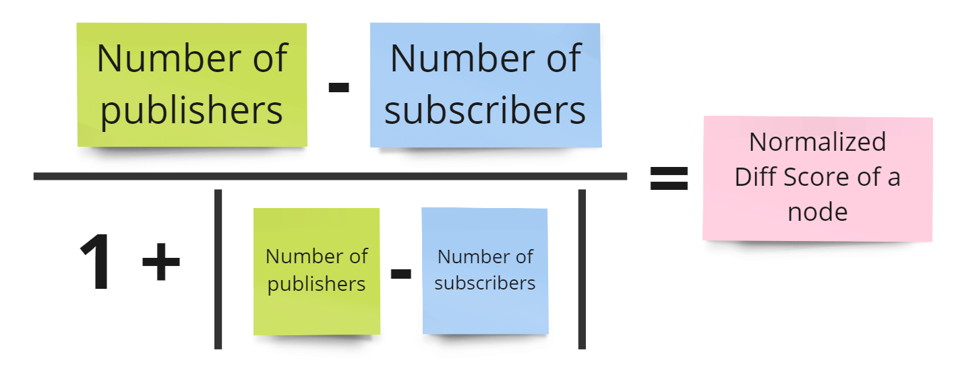
Calculating a „Source-Score“ of a Node
Heuristics:
The higher the score of a node
→ the more a node is a source of data
→ the earlier the generation of a node should be
(while still retaining the properties of topological generations)

Slide 56
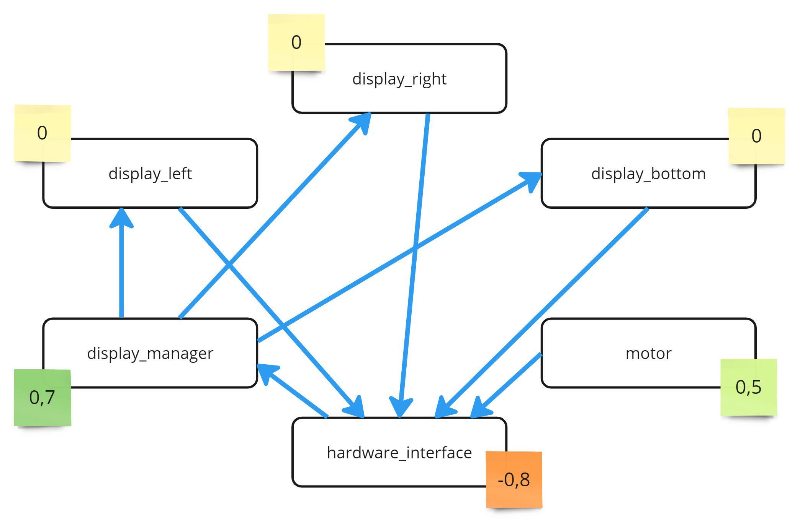
Source Scores in our Example

Slide 57
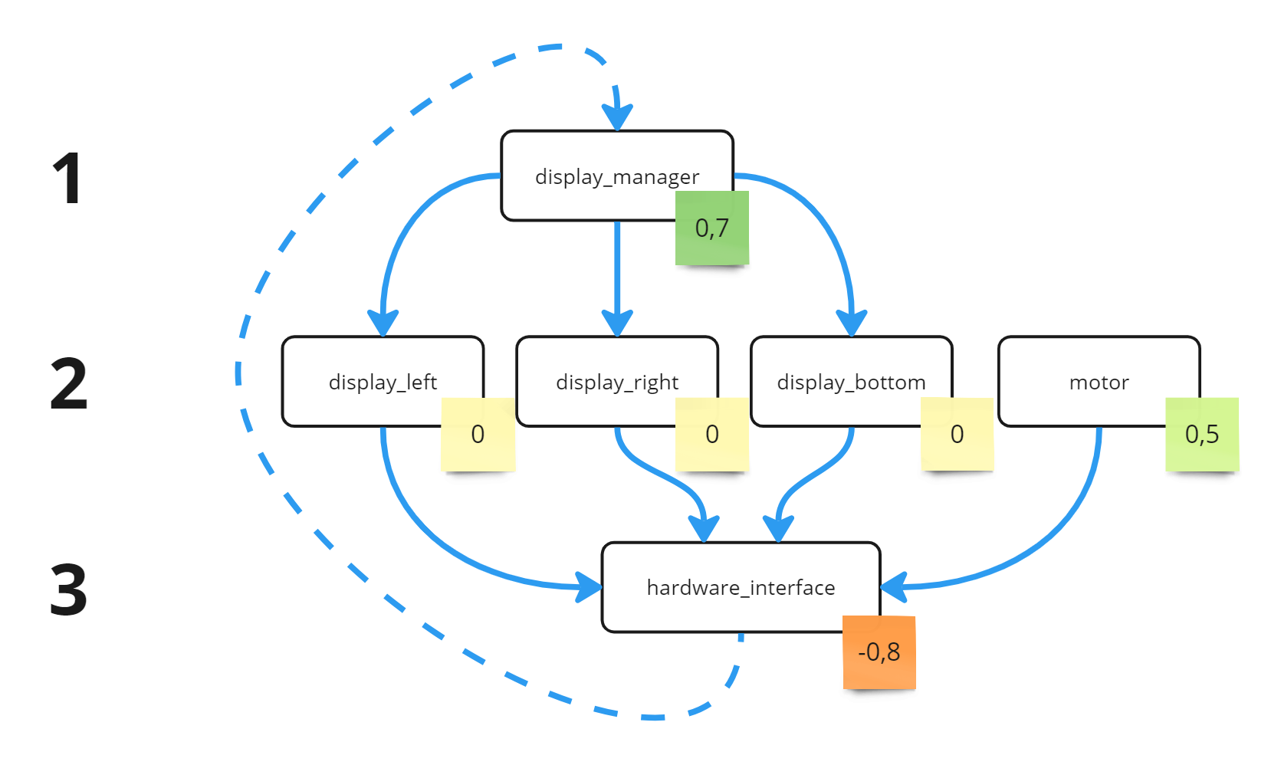
Algorithm to Retrieve Topological Generations
Simplified algorithm to calculate the generations:
While there are unassigned nodes:
select start node := unassigned node with highest score
add all successors, considering only forward connections
ignore connections that create circles

Slide 58
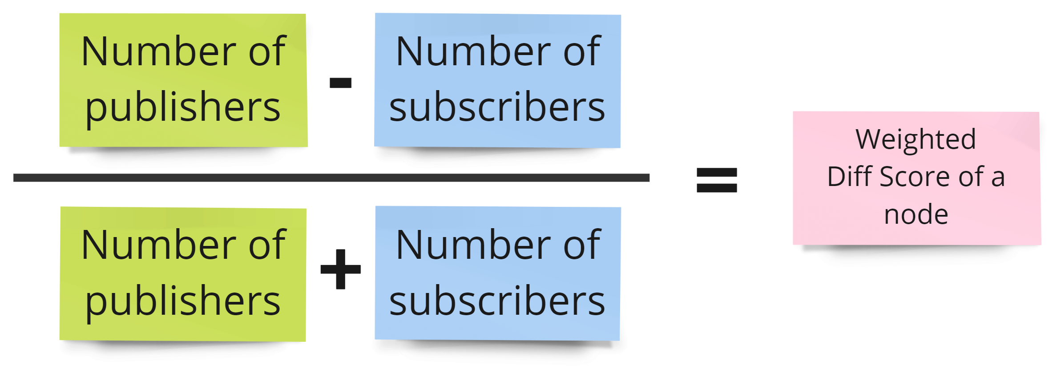
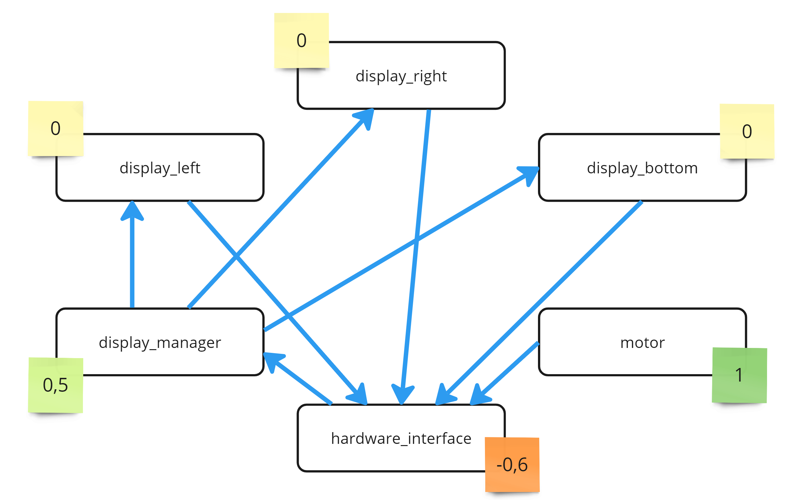
Algorithm to Retrieve Topological Generations
Result depends on Source-Score-Heuristics

Slide 59
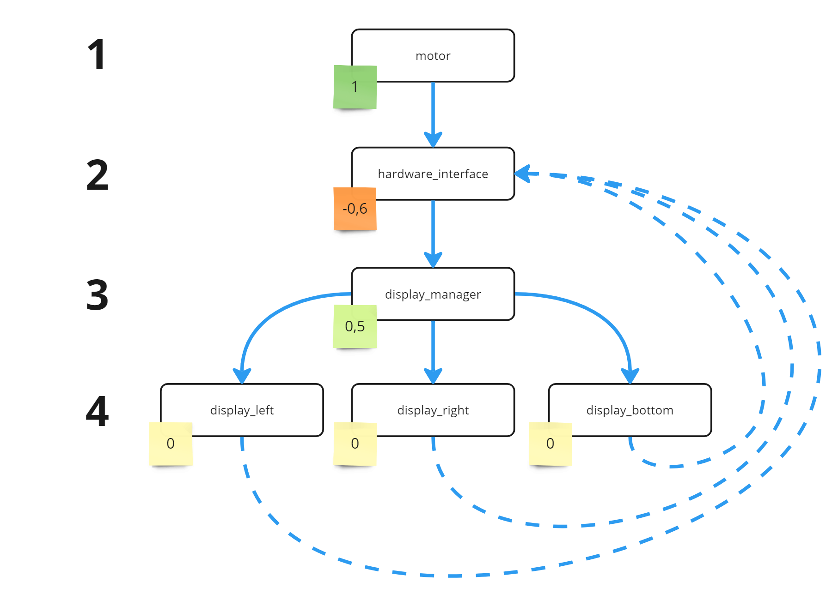
Algorithm to Retrieve Topological Generations
Result depends on Source-Score-Heuristics

Slide 60
Placement of the Nodes

Slide 61
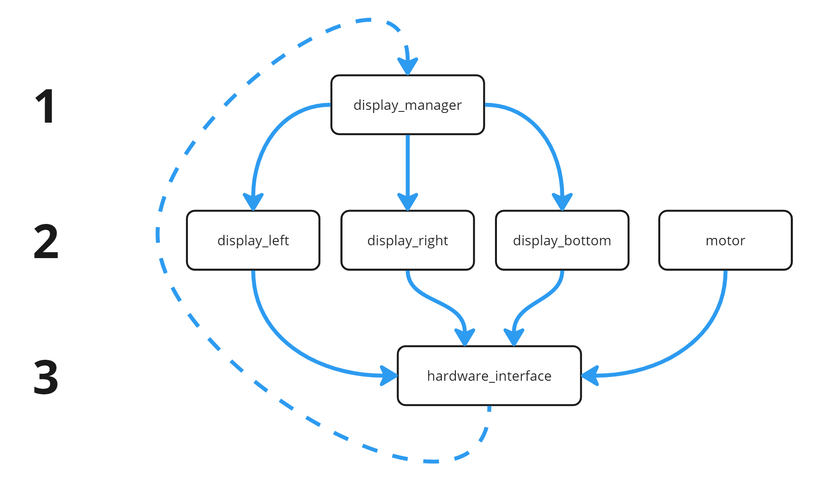
How to Place the Nodes
Placement according to Topological Generations is nice for simple graphs, but
not scalable at all

Slide 62
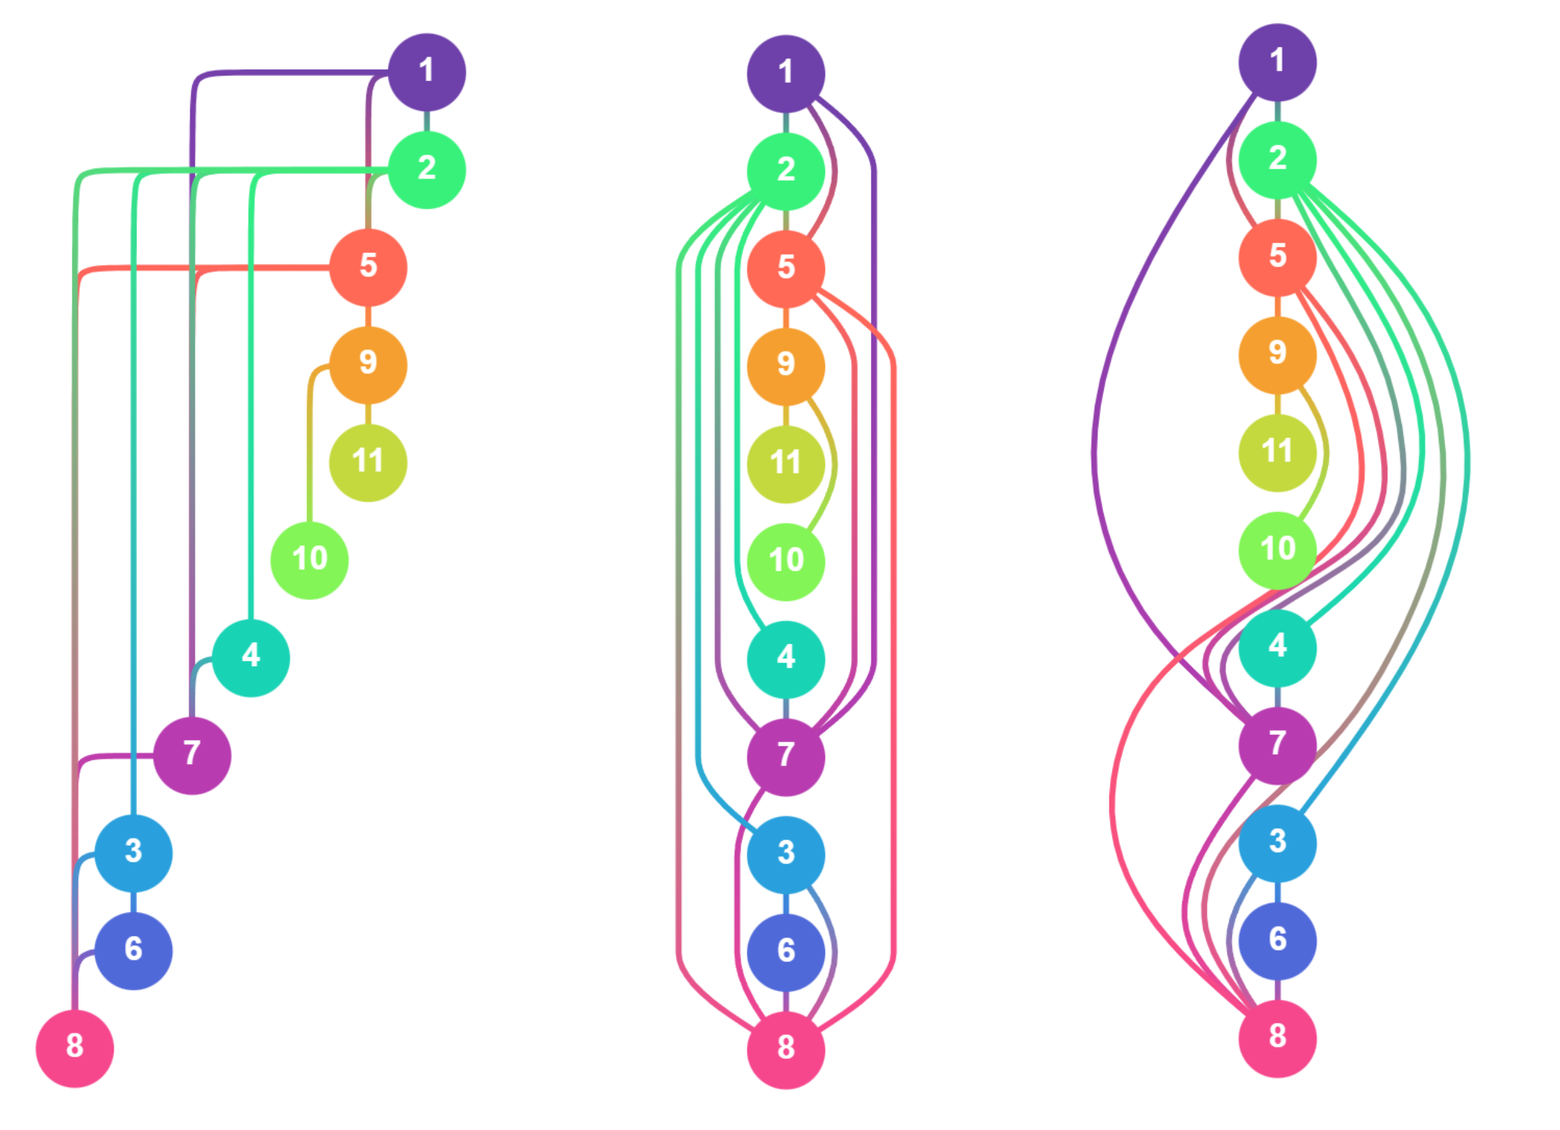
How to Place the Nodes
→ a lot of methods for DAGs linearize the arrangement of nodes
→ transfer from topological generations to topological sorting
DAG Drawings with the Sugiyama-Method according to:
Sugiyama, Kozo, Shojiro Tagawa, and Mitsuhiko Toda. "Methods for visual understanding of hierarchical system structures." IEEE Transactions on Systems, Man, and Cybernetics 11.2 (1981).

Slide 63
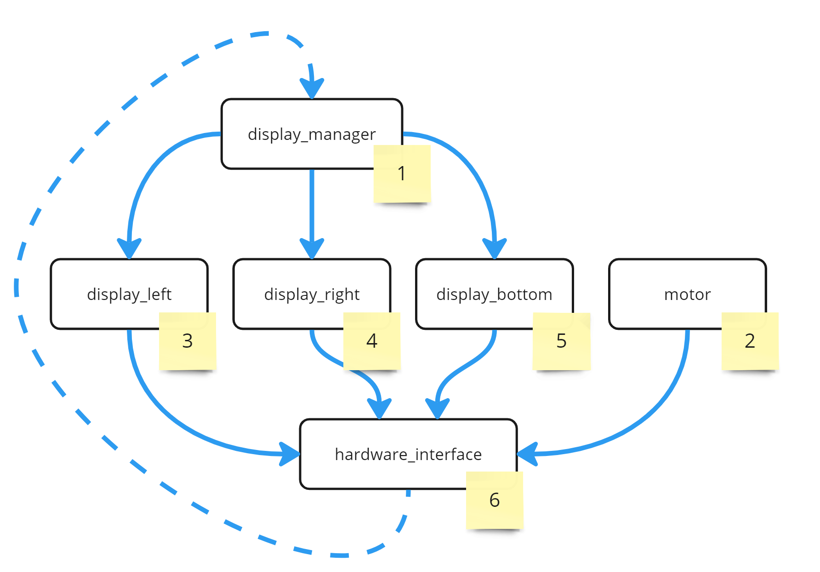
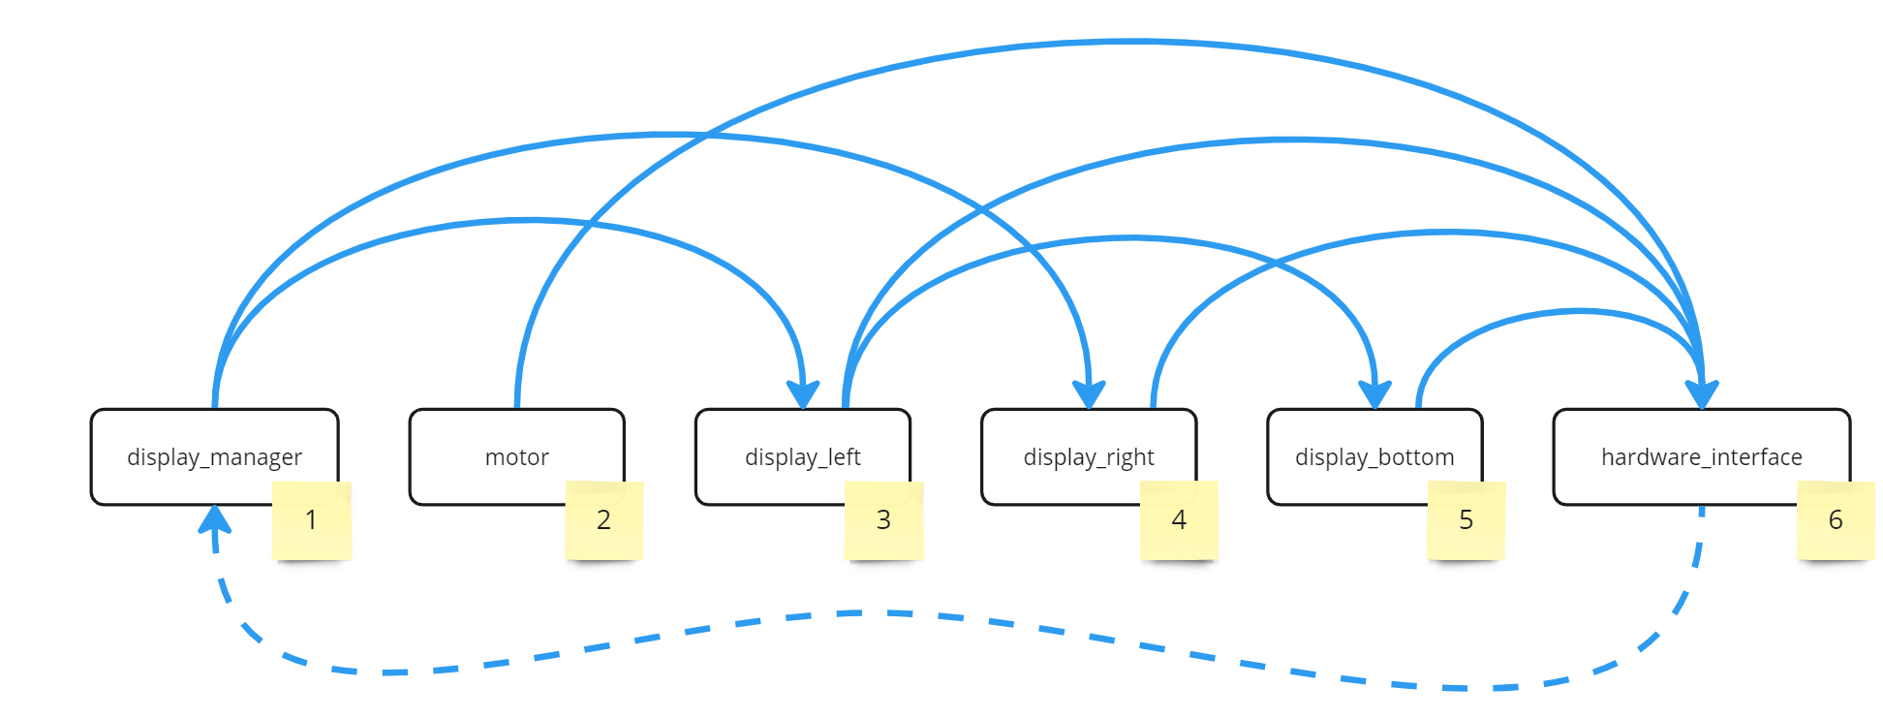
How to Place the Nodes
→ transfer from topological generations to topological sorting

Slide 64
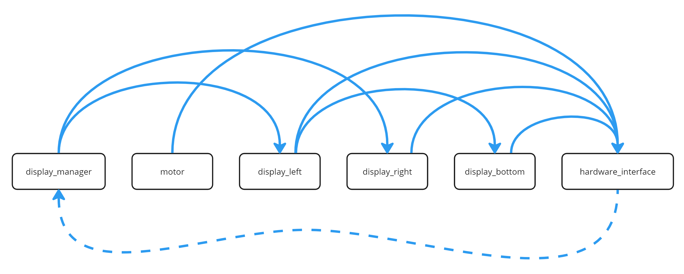
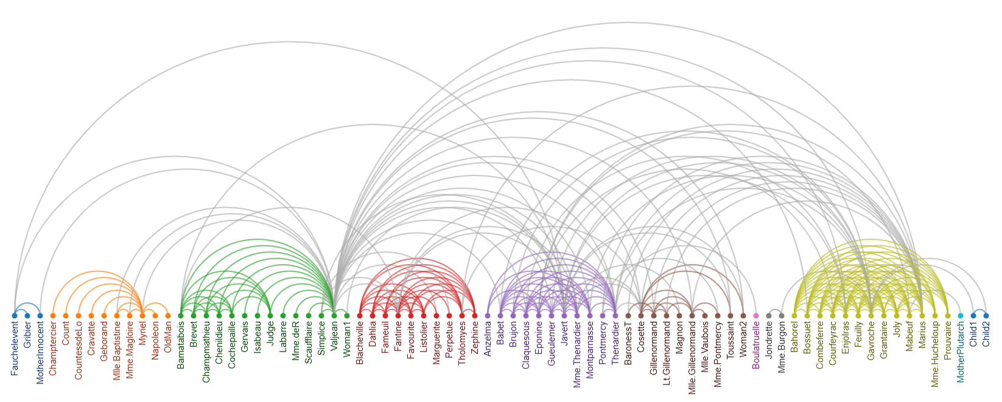
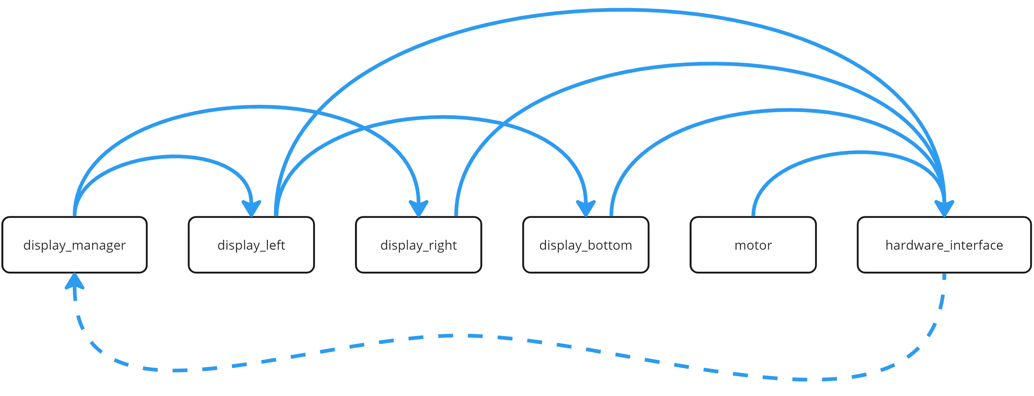
Problems with Plain Topological Linearization
Problem 1:
inefficient display utilization
Problem 2:
order of linearizing the generations is not neglectable for a good visualization!

Slide 65
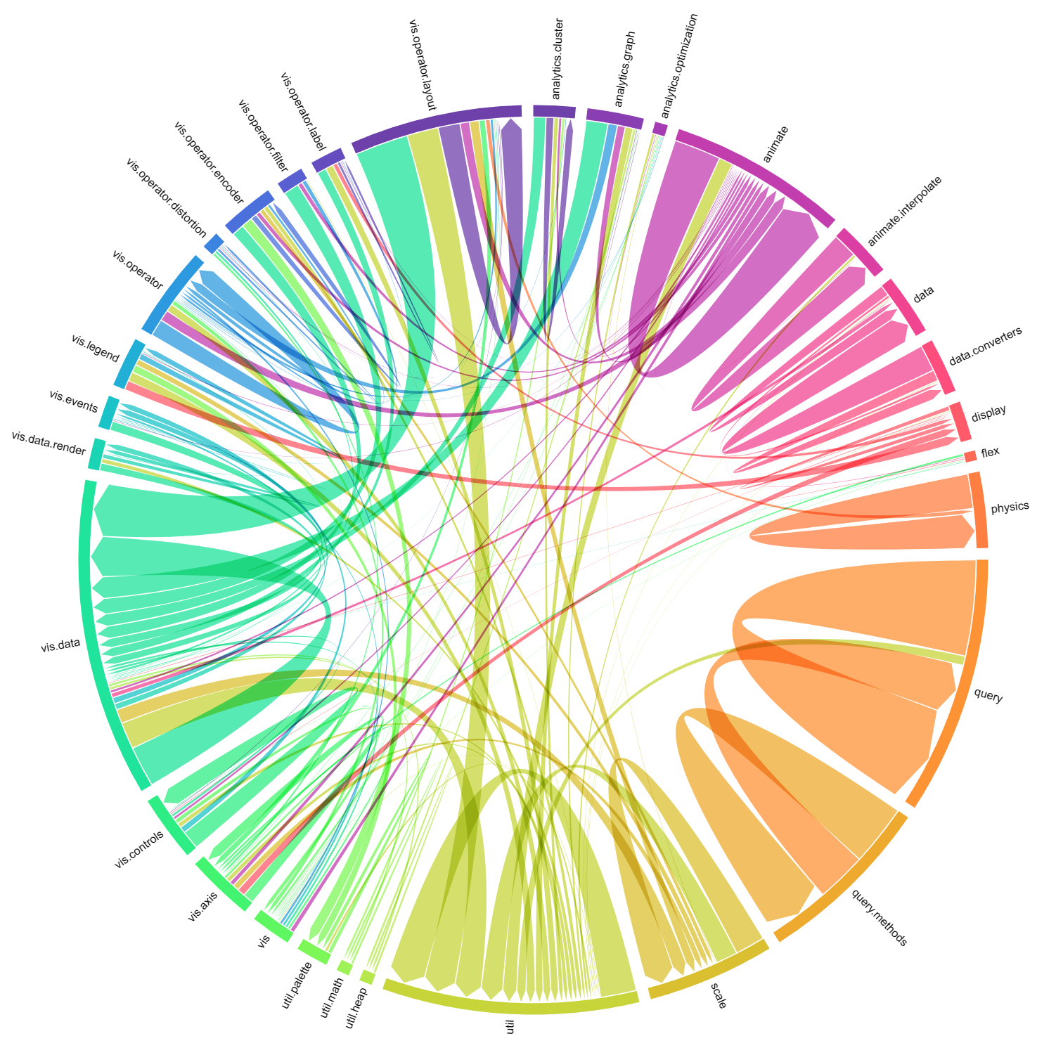
Circular Placement
Efficient Display Utilization

Slide 66
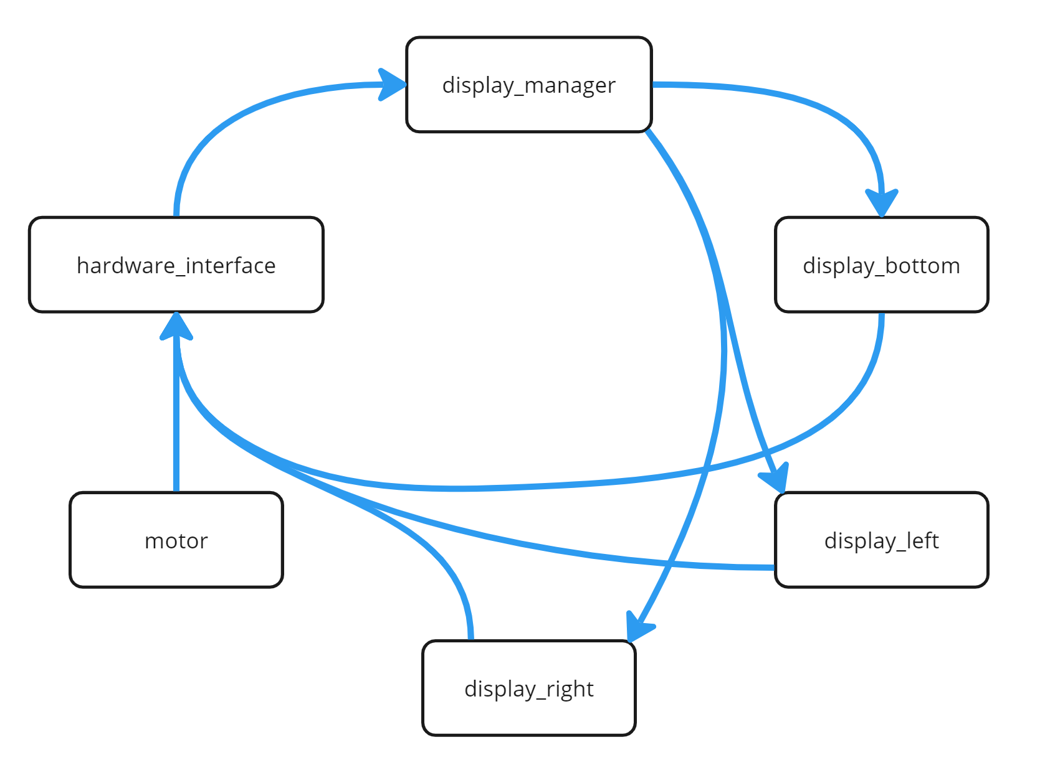
Circular Placement

Slide 67
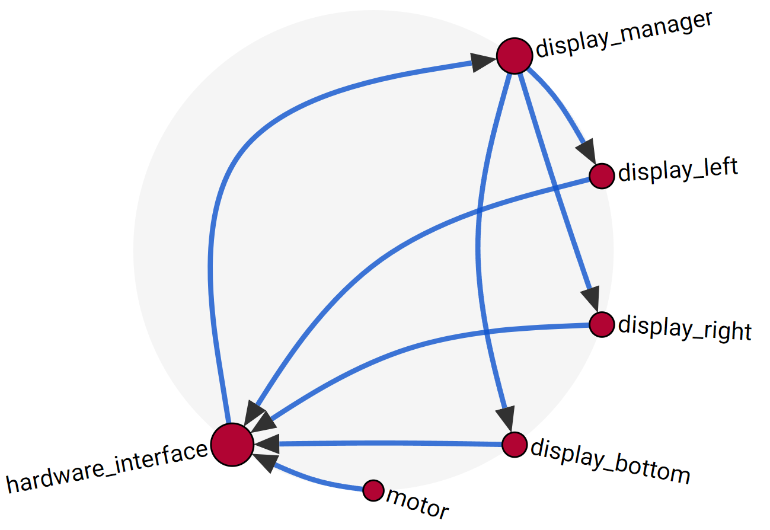
Circular Placement
Screenshot from the App

Slide 68
Flow Sorting
Sort nodes to minimize distances and edge crossing

Slide 69
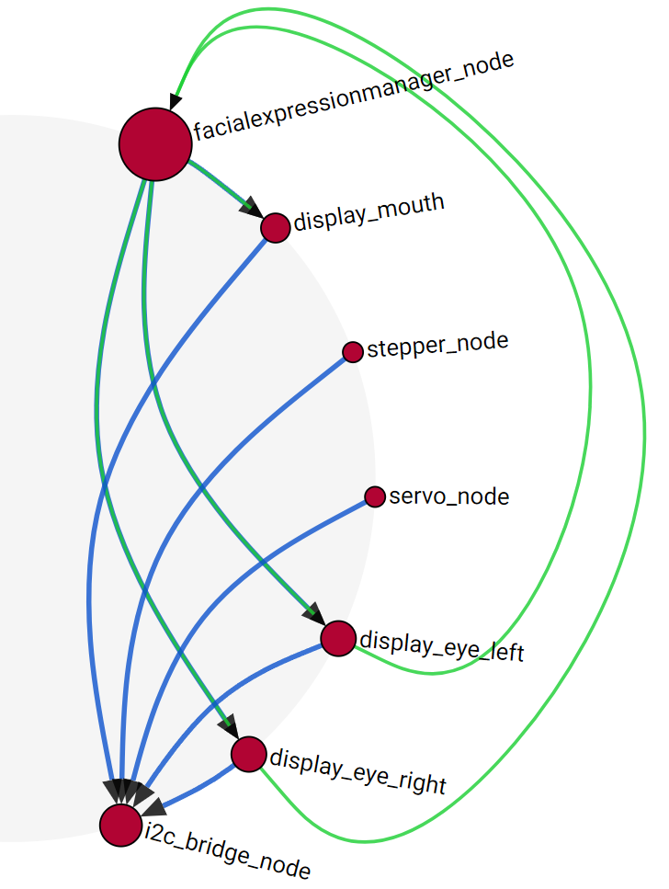
Flow Sorting
Linearization of topological generations does not consider neighborhood of nodes…
Linearized topological generations
Solution: Flow Sorting
==
Modified depth search try to minimize node distances and edge crossing

Slide 70
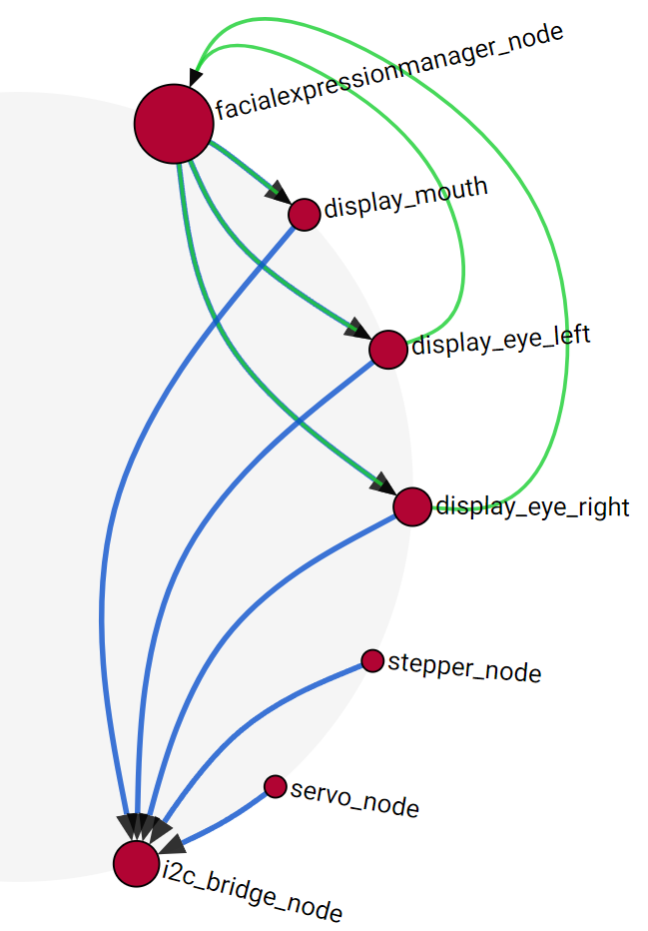
Flow Sorting
Linearization of topological generations does not consider neighborhood of nodes…
Flow sorted nodes
Solution: Flow Sorting
==
Modified depth search try to minimize node distances and edge crossing

Slide 71
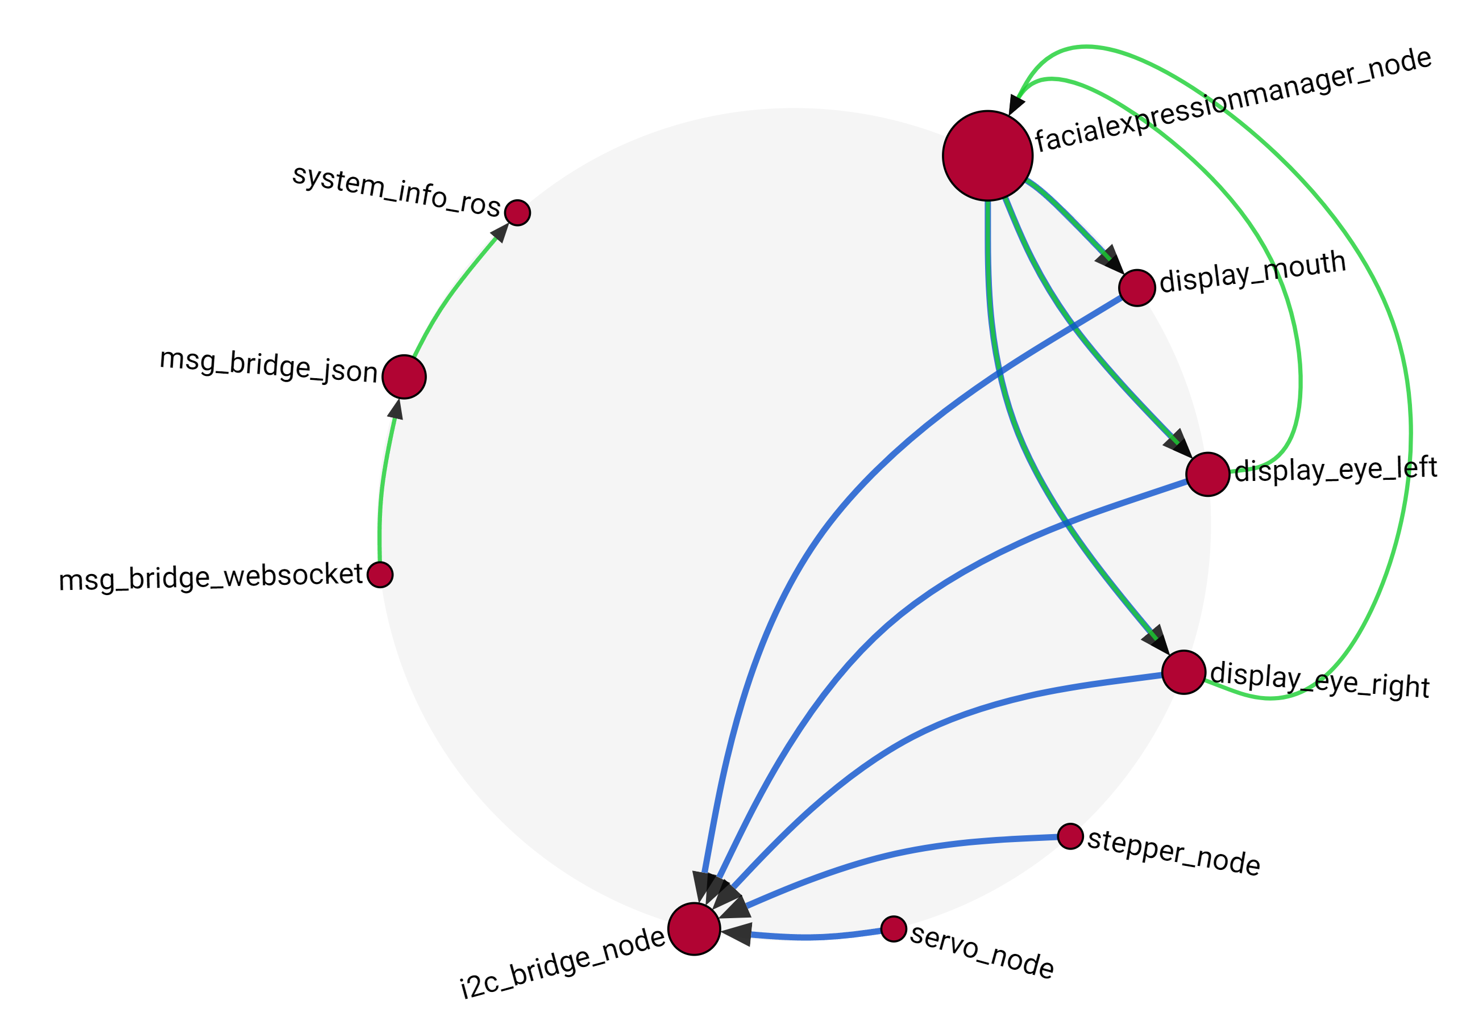

The Overview

Slide 72
The Overview
Overview
Details
Developer wants to see…
… which nodes exist in the system!
… which topics are offered by an node!
… how the nodes are connected!
… incoming and outgoing connections of a selected node!
… which nodes are central / important / strongly connected!
… connection details:
message types, etc.

Slide 73
The Overview
Overview
Details
… which nodes exist in the system!
… which topics are offered by an node!
… how the nodes are connected!
… incoming and outgoing connections of a selected node!
… which nodes are central / important / strongly connected!
… connection details:
message types, etc.
Following design principles of graph visualization summarized in:
Bennett, Chris, et al. "The aesthetics of graph visualization." CAe. 2007.

Slide 74
The Overview
Following design principles of graph visualization summarized in:
Bennett, Chris, et al. "The aesthetics of graph visualization." CAe. 2007.
Node Placement Heuristics:
Clustering of related nodes → clustering of connected nodes inside a connected component
Even distribution
minimum distance between nodes
number of different distant levels should be minimized → wew only 2 different levels: distance between different connected components & distance between nodes inside a connected component
No overlap of nodes (unless nested) → we have no nesting, nodes are evenly distributed without overlapping
Edge Heuristics:
Minimize number of edge crossings → done by flow sorting
Minimize number of edge bends / Keeping edge bends uniform → circular placement allows homogeneous edge bending, we don’t have to go around obstacles
Minimize max. edge length → done by circular placement
Placing edges at even angles around the node → not strictly done, but implicitly done by different positions of nodes on the circle
Graph Heuristics:
Minimizing total graph area → done by circle
Aspect ration should match container → 16:9 done by UI with circle as center
Flow Heuristics:
Maintain overall flow direction:
Inside the circle → clockwise flow
Outside the circle → counterclockwise flow

Slide 75

The Overview
Overview
Details
Developer wants to see…
… which nodes exist in the system!
… which topics are offered by an node!
… how the nodes are connected!
… incoming and outgoing connections of a selected node!
… which nodes are central / important / strongly connected!
… connection details:
message types, etc.

Slide 76

How to See Details?
… which topics are offered by an node!
… incoming and outgoing connections of a selected node!
… connection details:
message types, etc.

Slide 77

Details of ROS-Nodes
Displaying all details at once floods the screen
Solution:
Detail-View only for a selected central node

Slide 78

Details of ROS-Nodes
Selected node
Nodes with connections TO the selected node
Nodes with connections FROM the selected node
Topics of the selected node

Slide 79

Details of ROS-Nodes
Selected node
Nodes with connections FROM the selected node
2nd selected node
Topics of the selected node

Slide 80


Further Details of ROS-Topics

Slide 81

Live Demo

Slide 82
Conclusions

Slide 83

Conclusions: What we want to visualize
Overview
Details
Developer wants to see…
… which nodes exist in the system!
… which topics are offered by an node!
… how the nodes are connected!
… incoming and outgoing connections of a selected node!
… which nodes are central / important / strongly connected!
… connection details:
message types, etc.

Slide 84




Results of the Project
Algorithmic
Technical
Visual
Algorithm for heuristic computation of topological generations in directed-cyclic message graphs
Implementation of the created concepts in connection with ROS2
Implementation of various Vue.js-Components for SVG-Rendering of interactive message graphs based on D3.js
Algorithm for optimized linearized sorting of nodes in a directed-cyclic message graph

Slide 85
Future Work

Slide 86
Future Work
Easy deployability for other ROS-developers
Wishes from the user study
Include live Data
Add interactions on connections to see further information
Allow live system manipulation
Improve scaling!
Circular view is good for n < 50, for more nodes maybe breakout of connected components
More displayed information retrieved from documentation
(or from static code analysis/introspection…
A lot of possibilities and a lot of challenges)

Slide 87
Visualization of ROS2-Nodes
Thanks for your attention! :-)
Questions?

Slide 88
References
Robot Operation System:
Macenski, Steven, et al. "Robot Operating System 2: Design, architecture, and uses in the wild." Science Robotics 7.66 (2022): eabm6074.
Quigley, Morgan, et al. "ROS: an open-source Robot Operating System." ICRA workshop on open source software. Vol. 3. No. 3.2. 2009.
Visualization Principles:
Bennett, Chris, et al. "The aesthetics of graph visualization." CAe. 2007.
Stauffer, Michael, et al. "A review and extension of the visual information seeking mantra (VISM)." (2016).
Images from:
App screenshots are own captured
Sketch images created with Microsoft Bing Create
Company logos are the official logos

Slide 89
New planned architecture
Desktop Server System (Linux, etc.)
ROS-Environment
WebApp for Visualization
User Access
ROS-Nodes
Arbitrary nodes in the system
== ROS-Nodes (Python/C++)
== Web-App (Node.js + TypeScript)
== Developed during the project

Slide 90
New planned architecture
A lot of robots don’t have a display…
Desktop Server System (Linux, etc.)
NodeJS cannot communicate natively with ROS
ROS-Environment
WebApp for Visualization
User Access
ROS-Nodes
Arbitrary nodes in the system
== ROS-Nodes (Python/C++)
== Web-App (Node.js + TypeScript)
== Developed during the project

Slide 91
New planned architecture
Desktop Server System (Linux, etc.)
ROS-Environment
How to get Meta-Infos about the ROS-System?
Querying SystemInfo service data via WebSockets
ROS-Bridge Server
WebApp for Visualization
User Access
ROS-Nodes
Arbitrary nodes in the system
Generic
ROS-to-WebSocket Bridge
== ROS-Nodes (Python/C++)
== Web-App (Node.js + TypeScript)
== Developed during the project

Slide 92
New planned architecture
Desktop Server System (Linux, etc.)
ROS-Environment
provided Services
Meta-info about the current nodes in the system
Request ROS data via WebSockets
/get_all_node_names
SystemInfo Node
/get_all_topic_names
ROS-Bridge Server
WebApp for Visualization
User Access
ROS-Nodes
/get_publisher_by_node
/get_subscriber_by_node
…
Arbitrary nodes in the system
ROS-Node dedicated to provide meta-info
Generic
ROS-to-WebSocket Bridge
== ROS-Nodes (Python/C++)
== Web-App (Node.js + TypeScript)
== Developed during the project

Slide 93

Brief consideration of the requests
WebApp for Visualization
ROS-Bridge Server
def get_system_information():
# Get all ROS nodes in the system
nodes = request_all_nodes()
# Get the specific information for each ROS node
for node in nodes:
node.publishers = request_all_publishers(node)
node.subscribers = request_all_subscribers(node)
node.services = request_all_services(node)
node.clients = request_all_clients(node)
Problem:
ROS-Bridge struggeling with more than 10 requests at once…
→ (1 + 4*n) requests

Slide 94

Flow Sorting
Linearized topological generations
1. generation
1. generation
When linearizing the topological generations, neighboring nodes are not considered…
Solution: Flow Sorting
==
Modified depth search try to minimize node distances and edge crossing

Slide 95

Flow sorting
Flow sorted nodes
1. generation
When linearizing the topological generations, neighboring nodes are not considered…
1. generation
Solution: Flow Sorting
==
Modified depth search try to minimize node distances and edge crossing

Slide 96

Calculating a „Source-Score“ of a Node
The higher the score of a node
→ the more a node is a source
→ the lower should the generation of a node be
(while still retaining the properties of topological generations)

Slide 97
Source Scores in our Example

Slide 98
Algorithm to Retrieve Topological Generations
Strongly simplified algorithm:
While there are unassigned nodes:
select start node = unassigned node with highest score
add all successors, considering only forward connections.
ignore connections that create circles
Calculate generations based on stored parents of this process.

Slide 99


Algorithm to Retrieve Topological Generations
Result depends on Source-Score-Heuristics

Slide 100
Algorithm to Retrieve Topological Generations
Result depends on Source-Score-Heuristics

Slide 101
Characteristics of the ROS Nodes

Slide 102

Motivation for a visualization

Slide 103

The problem with multi-node-systems
Lots of different ROS nodes…
no documentation…
… and even more topics
source code mining…
ask the original
developer…
User needs to know which nodes and topics are present!

Slide 104
Use Cases
Overview
Details
Developer wants to see…
… which nodes exist in the system!
… which topics are offered by an node!
… how the nodes are connected!
… dataflow between selected nodes!
… which nodes are central / important / strongly connected!
… see message details:
messageType,
content, frequency,
package size, etc.
→ Interactive visualization to support development process

Slide 105

State of the Art

Slide 106


The existing visualization: rqt_graph

Slide 107

The existing visualization: rqt_graph

Slide 108
The existing visualization: rqt_graph
Only 13 nodes

Slide 109

Approach of rqt_graph
Overview:
shows all nodes (…as an arbitrarily chosen representation of topological generations)
shows all topic connections between nodes
displays all names (nodes and topics)
Filtering:
some nodes can be hidden (e.g. known temporarily nodes)
some topics can be hidden (e.g. leaf topics)
Zoom:
does only change view box
no more or less information by zooming
Details:
in other programs, not in the actual rqt_graph app
A review and extension of the Visual Information (iiis.org)

Slide 110
Problems of rqt_graph
visual cluttering
no interaction (beside some hover effects)
manual refreshing
requires a ROS Desktop environment

Slide 111
Our approach

Slide 112

New approach
Overview (Node-focused):
existing nodes
potential hierarchies
potential clusters
strongly connected / central nodes in the system
no information flooding!
Zoom In (Node-Topic-focused):
topics of a node
topic connections of a selected node to other nodes
Zoom Out (Multi-Node-Dataflow-focused):
path from one node to another
topic connections along this path
Details and Multi-View:
details of a node (like parameter, namespace, etc.)
details of a topic (like message type definition)
A review and extension of the Visual Information (iiis.org)

Slide 113






Visualization approaches for overview
Topological DAG Drawing
Arc
Force Directed Graph
Other

Slide 114

Planned architecture

Slide 115

Technical details
Data
(Live from ROS-System)
Visualization
(WebApp)
Platform
Raspberry Pi 4
Ubuntu (potentially Raspberry Pi OS)
Platform
arbitrary development (…Windows for me)
Framework
Node.js + Vue.js
D3.js
Framework
ROS2 Humble
Languages
Python for custom ROS-Nodes
Languages
TypeScript / JavaScript (Node.js)
Libraries
RobotWebTools/rosbridge_suite (github.com)
for ROS-to-WebSocket Bridging

Slide 116





Milestones
ROS System Setup
Retrieving data from ROS in WebApp
Done
SystemInfo Node
ROS-side development
Transforming data into graph structure
WebApp for Visualization
Suitable method for overview visualization / layouting (after implementing and comparing multiple approaches)
Up next
Methods for interaction and detailed visualization of single nodes (with different levels of detail)
Interactive methods to visualize data flow between fixed nodes
Investigation of methods for the detection of clusters and hierarchies
Later
Visualization of Live-Data

Slide 117












Visualization of ROS2-Nodes
Thanks for your attention! :-)
Questions?

Slide 118
acquire
parse
filter
mine
represent
refine
interact
Fry, B. (2008). Visualizing data: Exploring and explaining data with the processing environment. O’Reilly Media, Inc.

Slide 119


The existing visualization: rqt_graph

Slide 120









